Slide 1



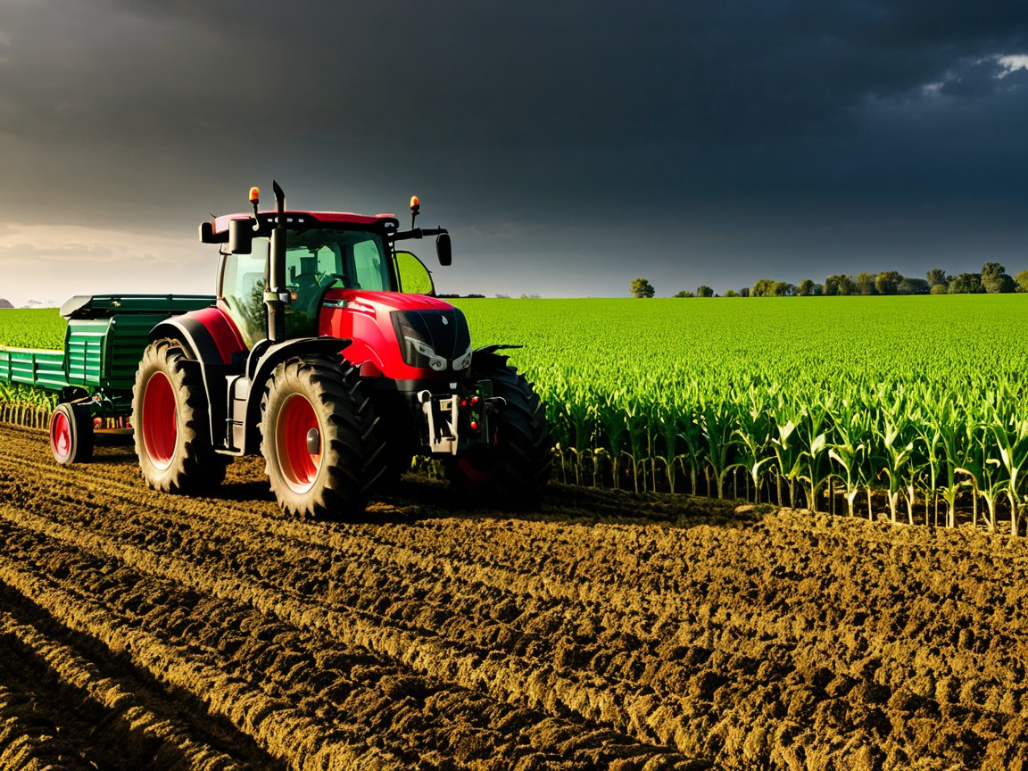
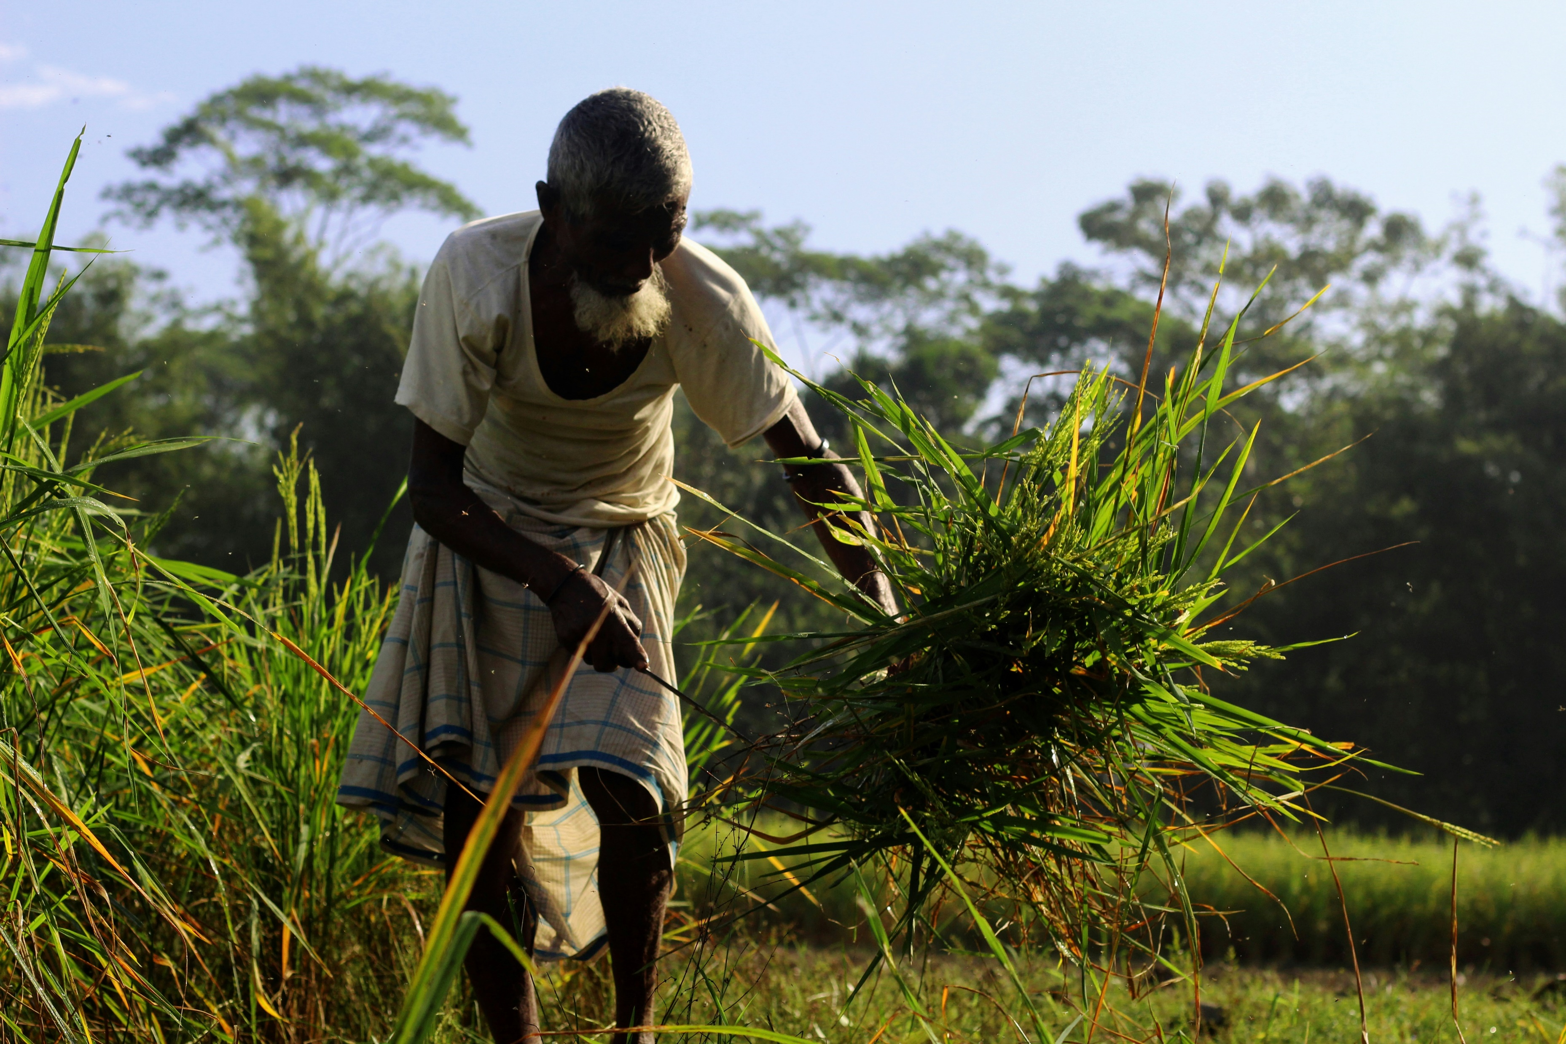
Farmigo
Empowering Farmers, Landlords, and Buyers through Data Management

Slide 2
Farmigo
Empowering Urban Farms with
Smart Optimization

Slide 3
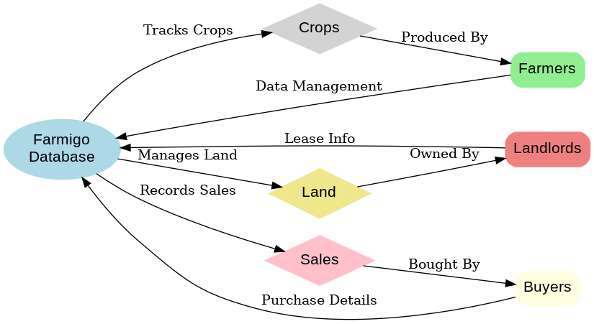


Farmigo
Farmigo is an innovative database system designed
to simplify agricultural operations.
Seamlessly connects farmers, landlords, crops, and buyers for efficient resource management.
Supports data-driven decisions with insights.

Slide 5
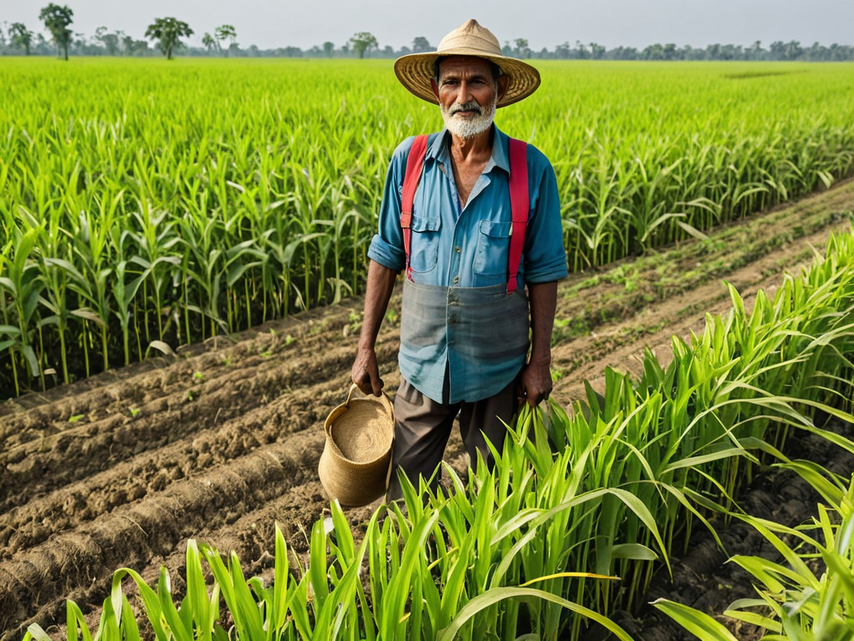
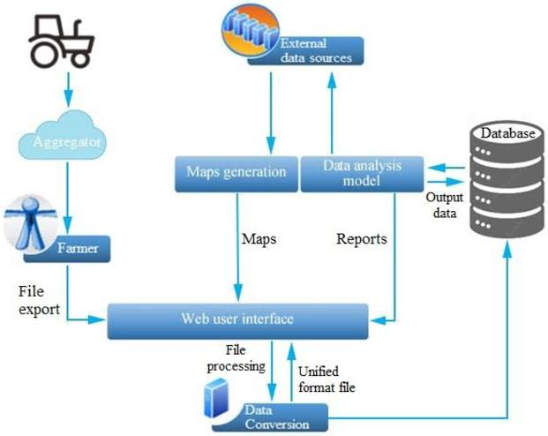




Farmigo
Centralized Agricultural Data:

Slide 6
Farmigo
Centralized Agricultural Data:
A one-stop platform to manage farm resources, crop details, and stakeholder information efficiently.

Slide 7
Farmigo
Operational Insights:
Improve productivity through crop health monitoring, weather data integration, and resource management.

Slide 8
Farmigo
Financial Management:
Streamline loans, sales tracking, production costs, and repayment schedules for better financial control.

Slide 9
Farmigo
Stakeholder Collaboration:
Enhance communication and transparency among farmers, landlords, and buyers for seamless operations.

Slide 10
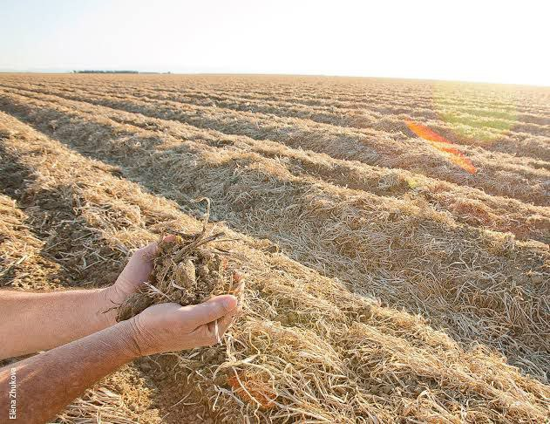

Farmigo
Scalability and Future Readiness:
A flexible system built to adapt to growing agricultural demands, including predictive analytics and advanced reporting.

Slide 11
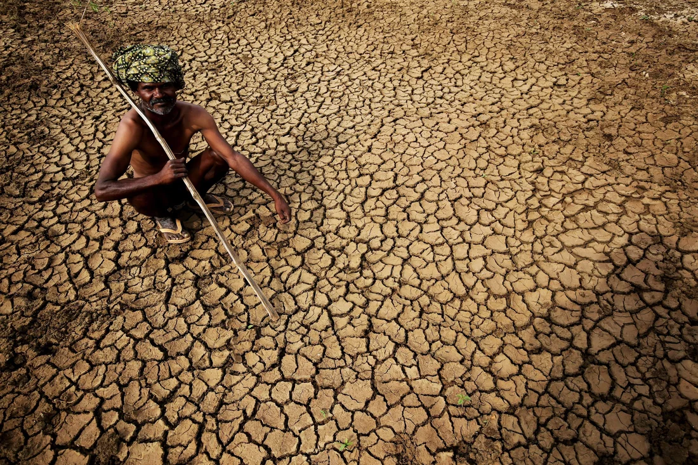

Problem Statement
Existing agricultural management systems are plagued by manual processes, disconnected data, and limited integration of critical factors like weather and financial tracking. This leads to inefficiencies, poor decision-making, and hindered growth in the agricultural sector, ultimately affecting productivity and profitability.

Slide 12
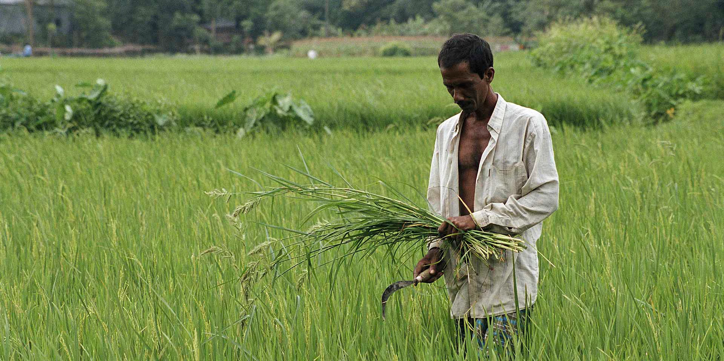


Key Challenges

Slide 13
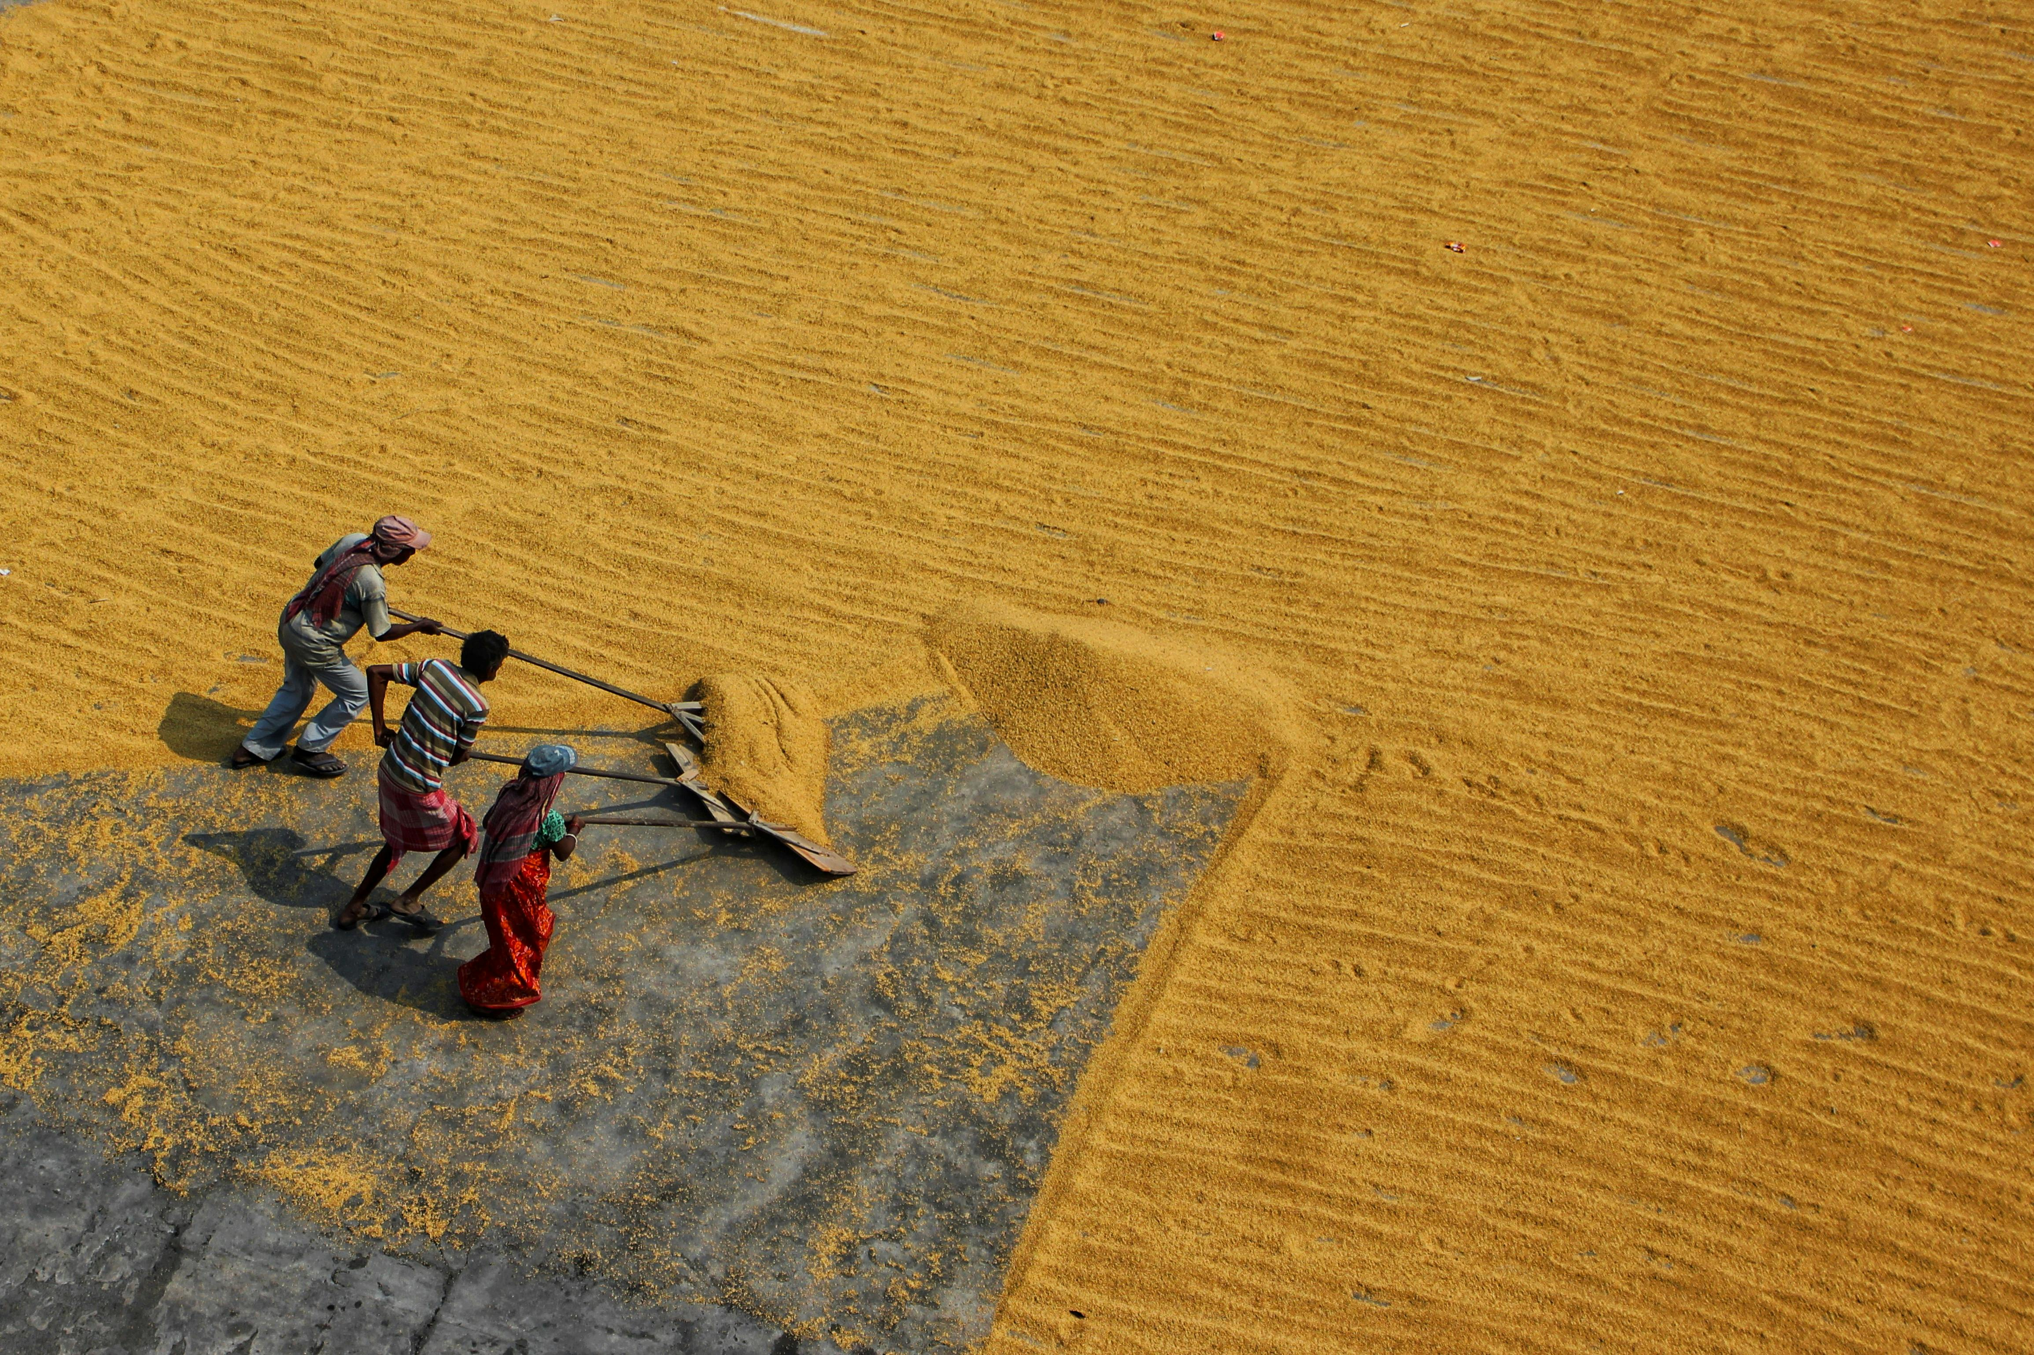
Inadequate Crop Health Monitoring
Notes:
: Farmers lack a systematic way to monitor crop health, leading to missed interventions and reduced yields.

Slide 14
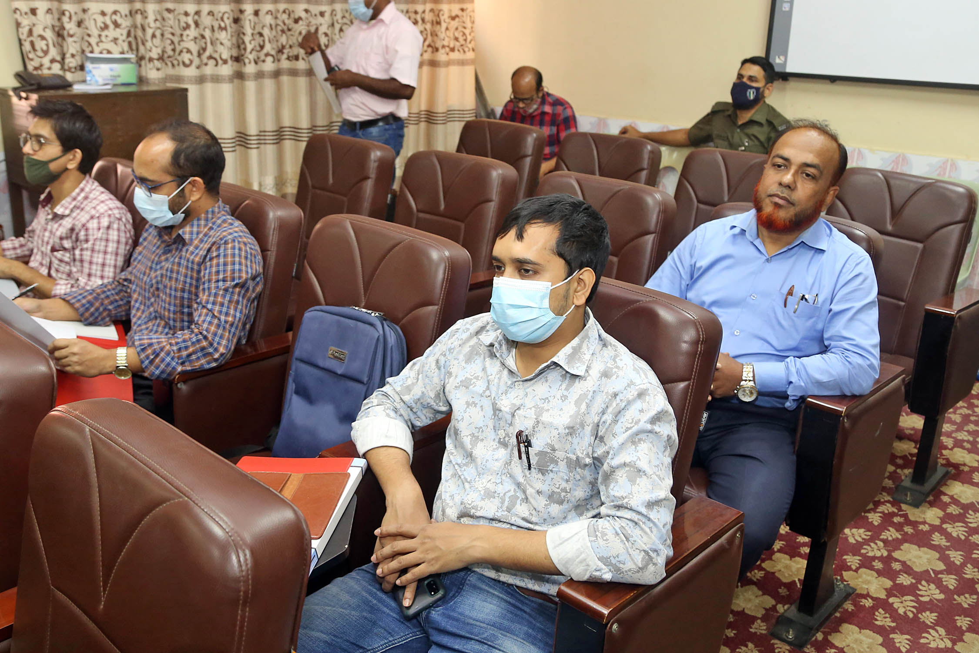
Lack of Financial Tracking
Notes:
: Farmers lack a systematic way to monitor crop health, leading to missed interventions and reduced yields.

Slide 15
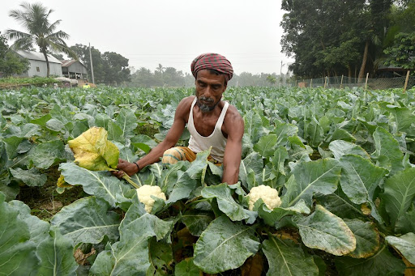
Disconnected Stakeholder Communication
Notes:
: Farmers lack a systematic way to monitor crop health, leading to missed interventions and reduced yields.

Slide 16
Manual Data Management
Notes:
: Farmers lack a systematic way to monitor crop health, leading to missed interventions and reduced yields.

Slide 17
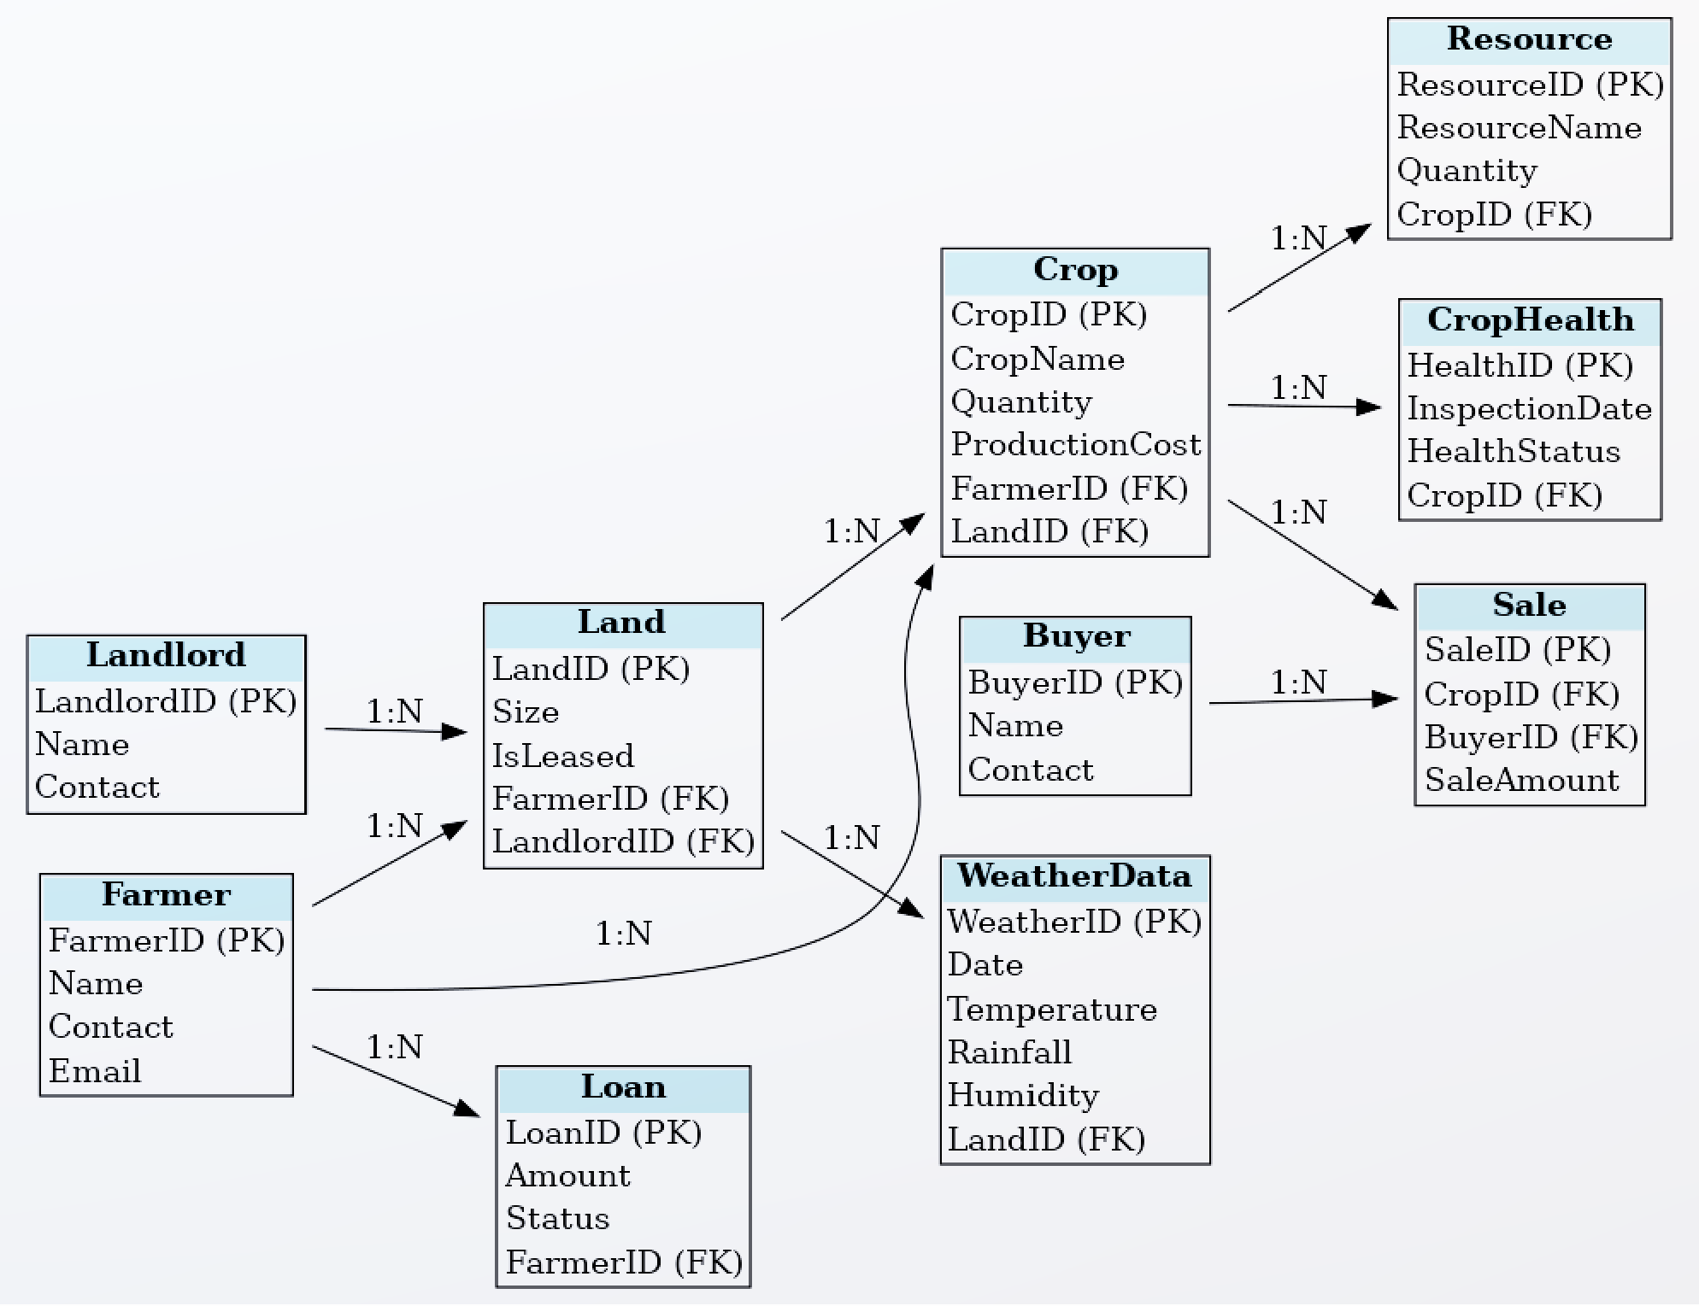
Manual Data Management
Notes:
: Farmers lack a systematic way to monitor crop health, leading to missed interventions and reduced yields.

Slide 18
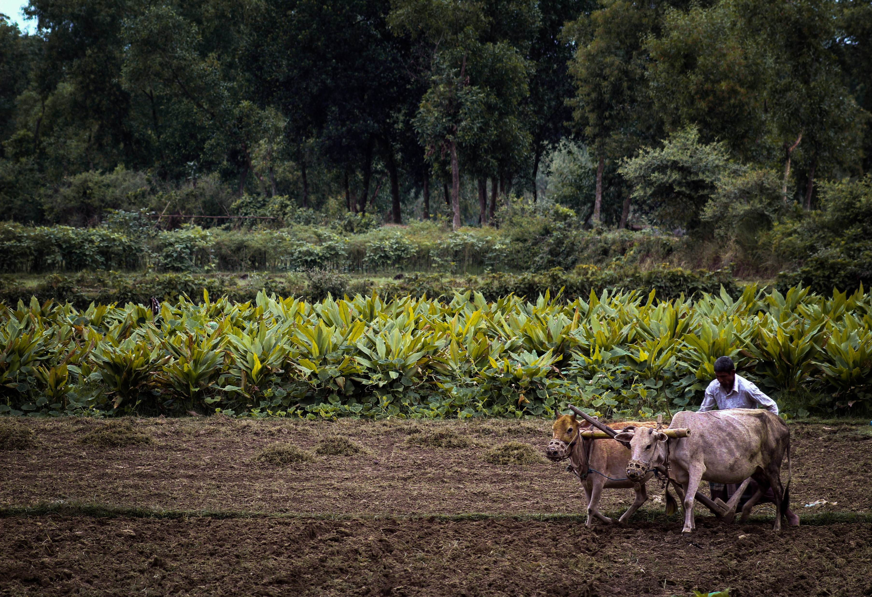
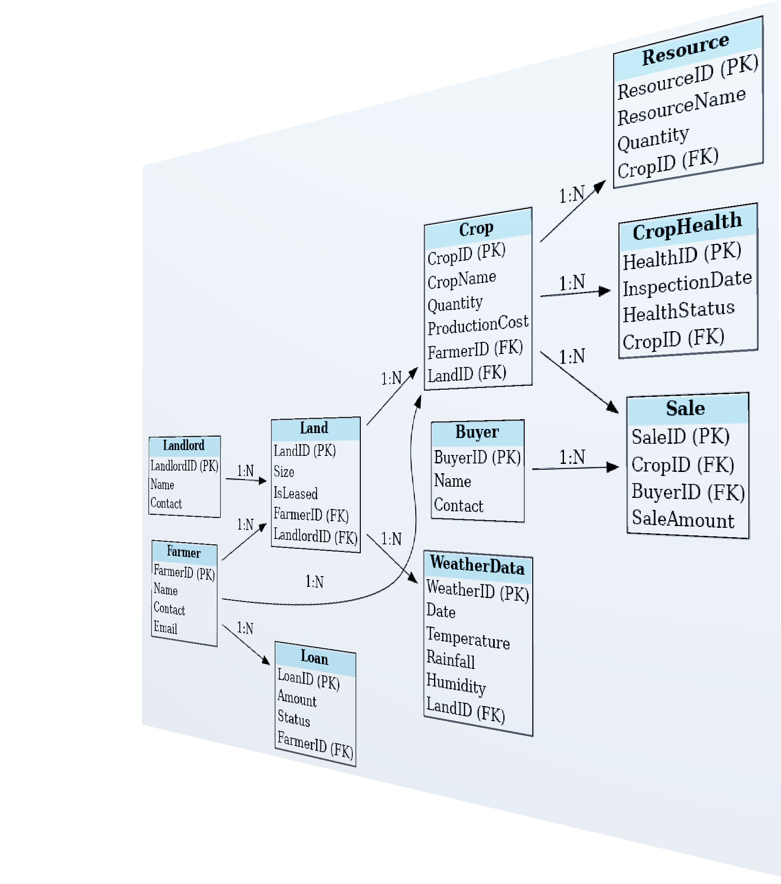
Database Design Overview
Key Components:
10 interconnected tables covering farmers, crops, sales, weather, and more.
Strong relationships ensure data integrity and accuracy.
Design Principles:
Normalized schema for efficient storage.
Scalable structure for future enhancements.
Notes:
: Farmers lack a systematic way to monitor crop health, leading to missed interventions and reduced yields.

Slide 19

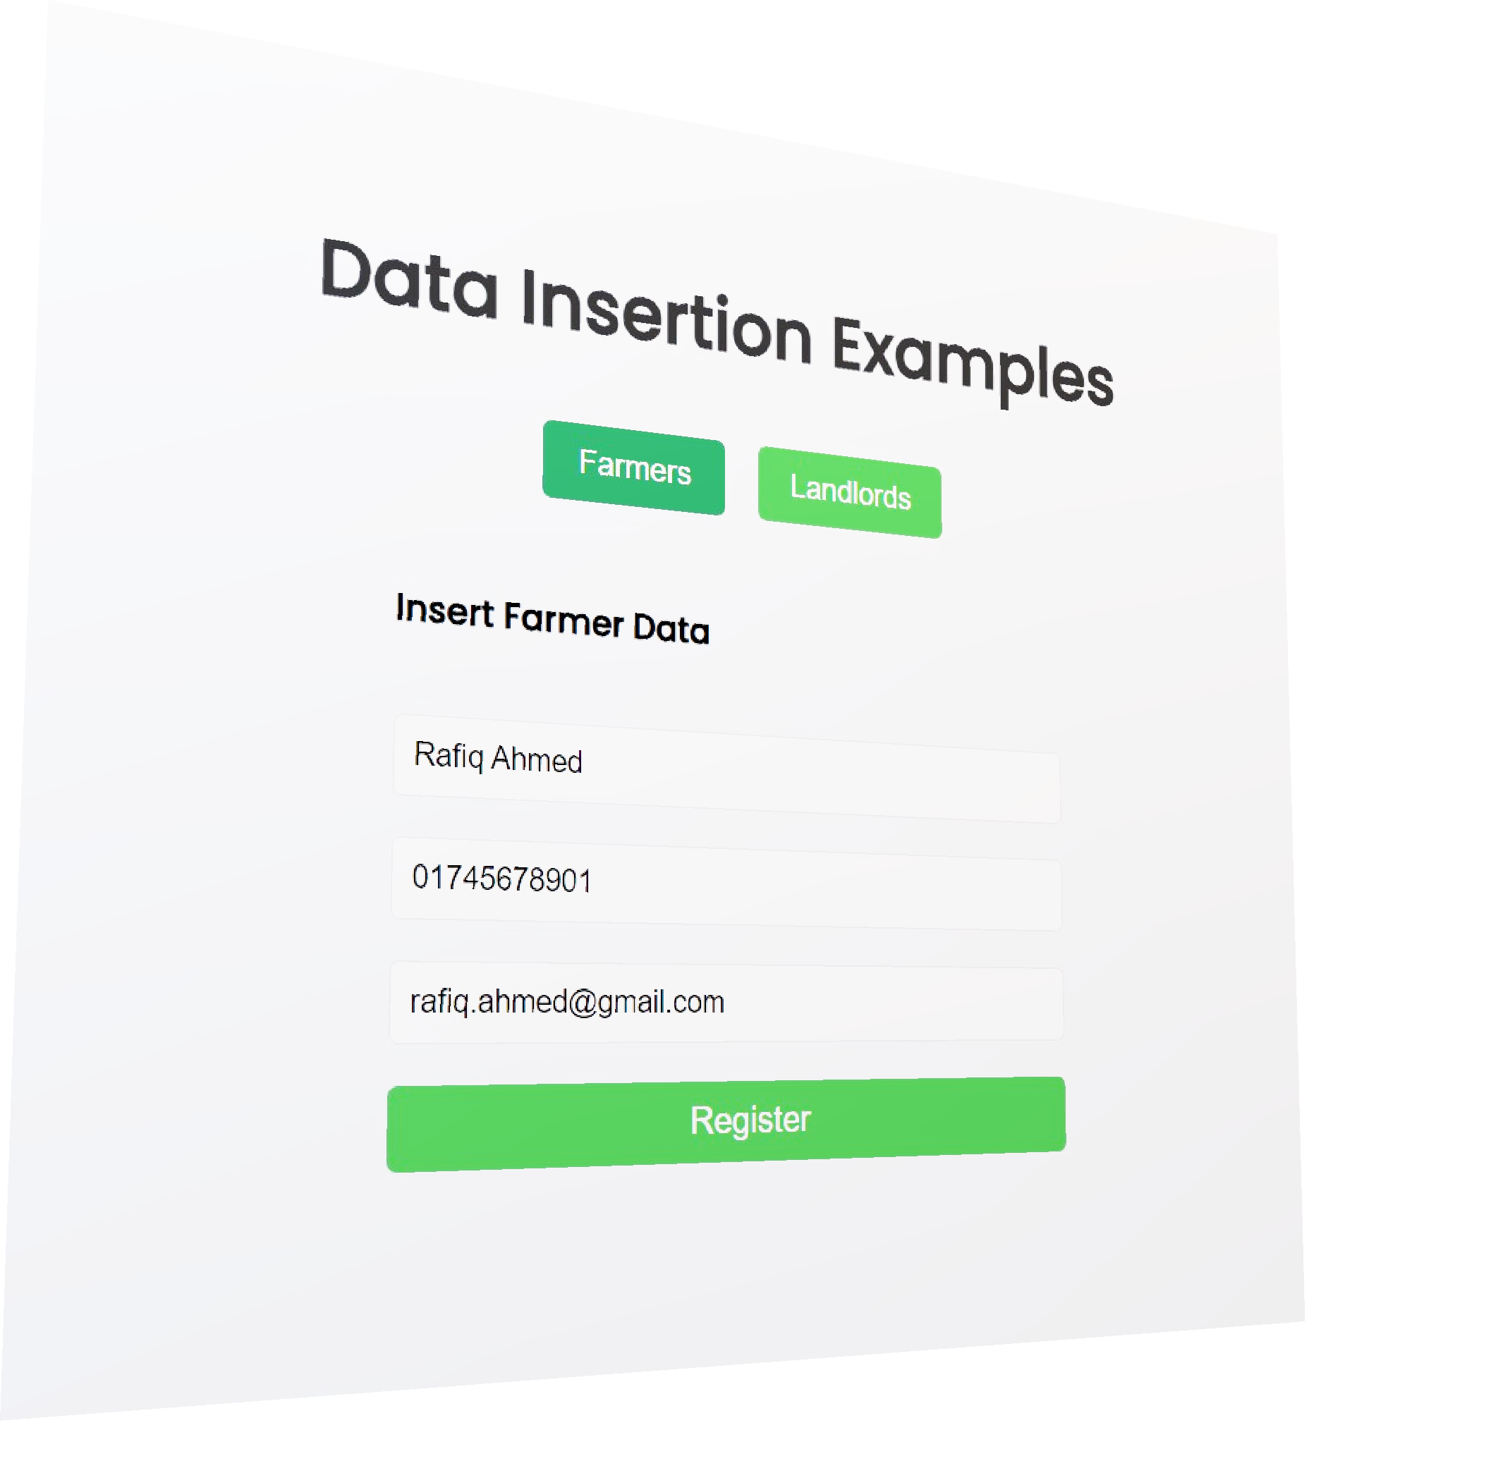
Key Tables and Relationships
Farmer Table: Manages farmer details.
Crop Table: Tracks crops, production costs, and health.
Weather Data Table: Captures weather data for informed decisions.
Loan Table: Monitors financial aid and repayments.
Interconnections allow comprehensive analysis of operations.
Notes:
: Farmers lack a systematic way to monitor crop health, leading to missed interventions and reduced yields.

Slide 20
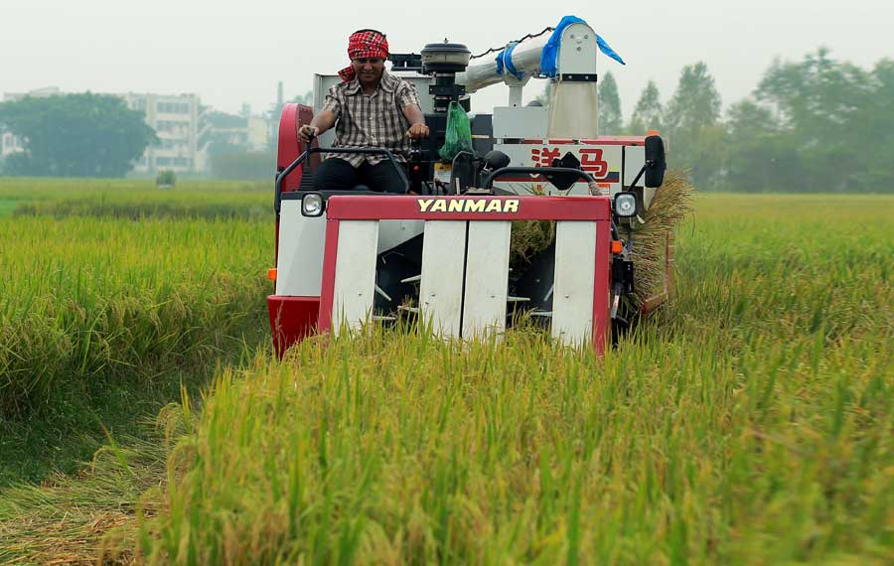

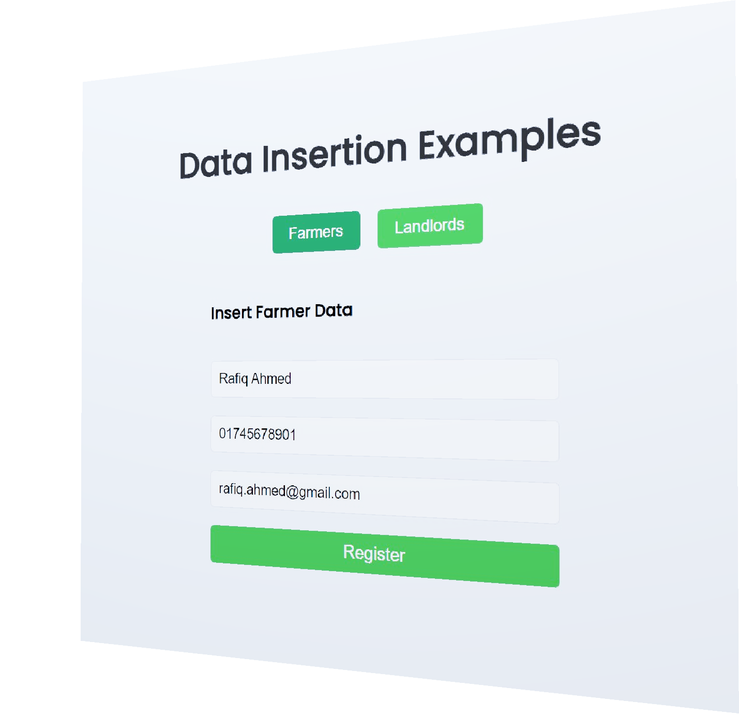
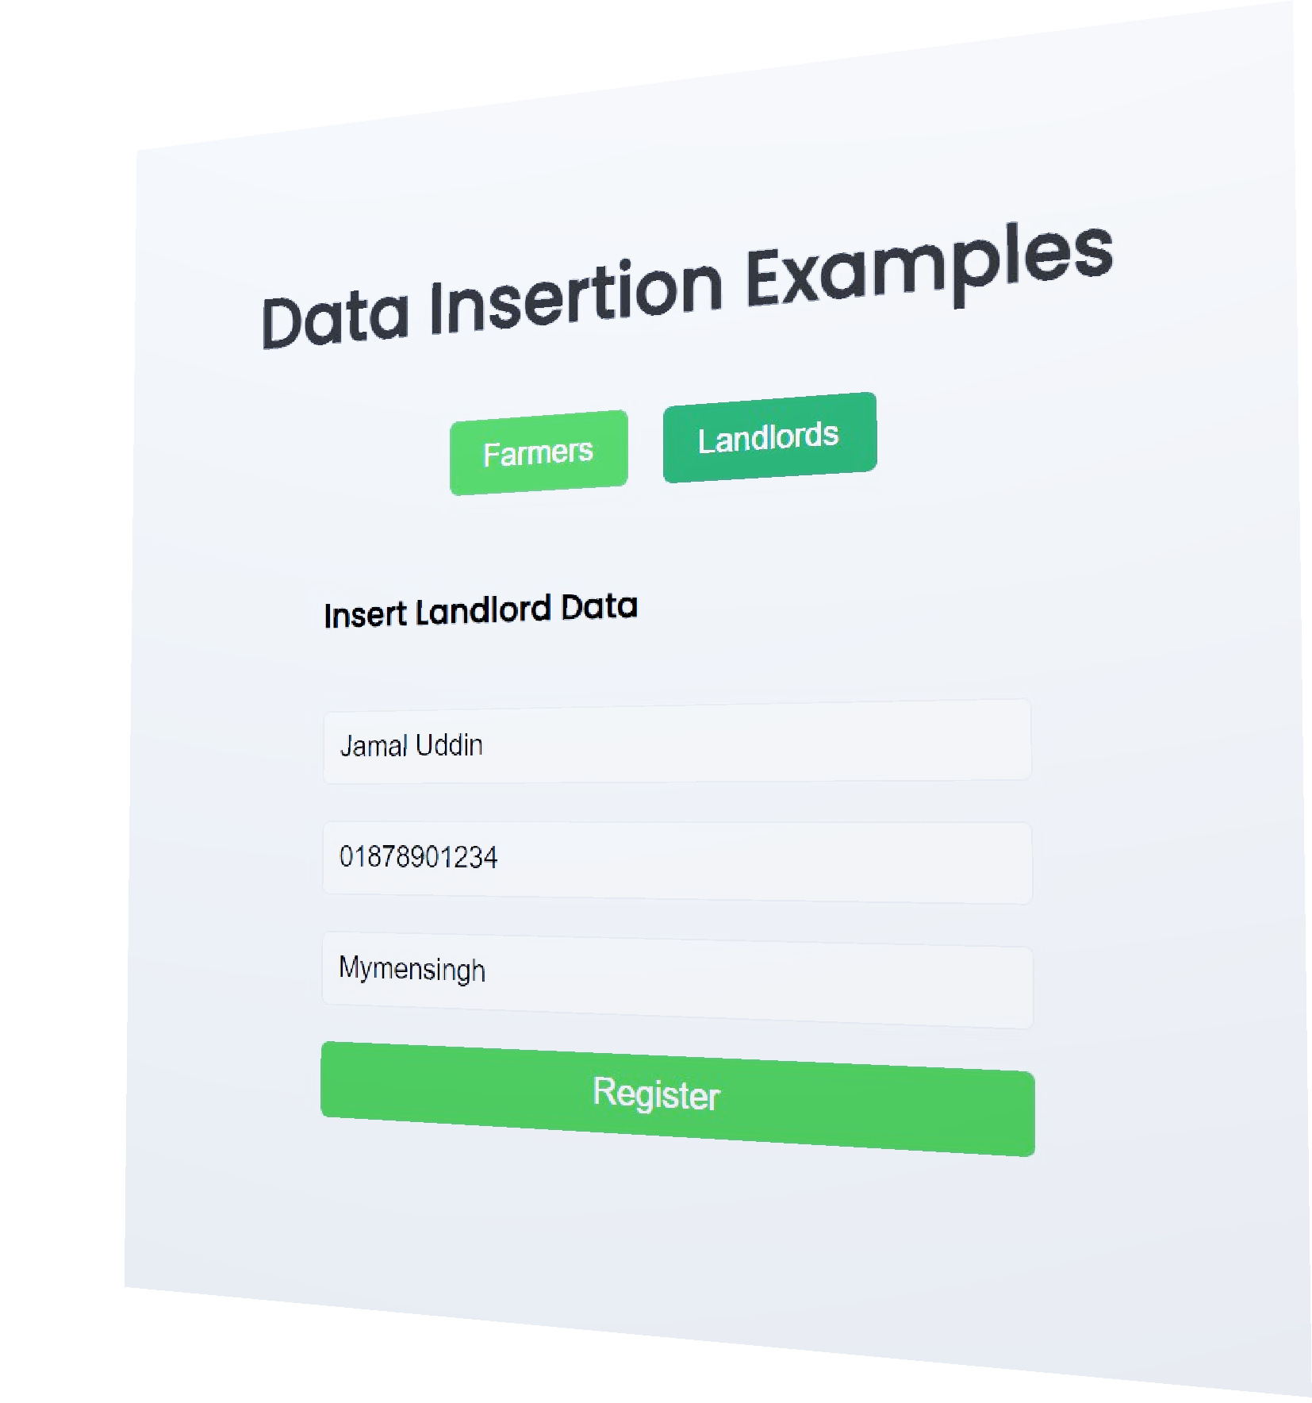
Data Insertion Examples
Farmers
Notes:
: Farmers lack a systematic way to monitor crop health, leading to missed interventions and reduced yields.

Slide 21
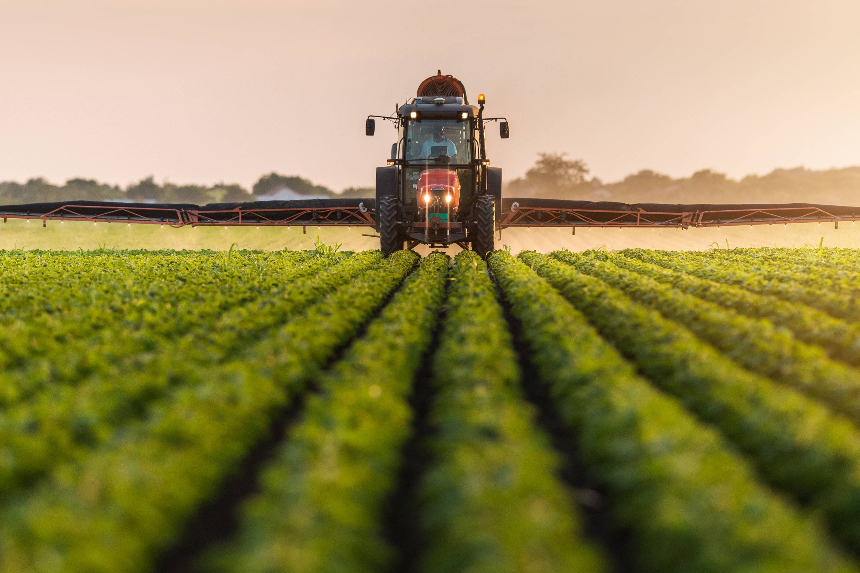
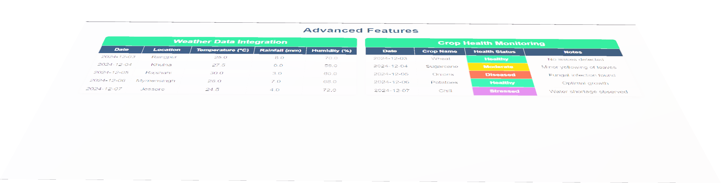
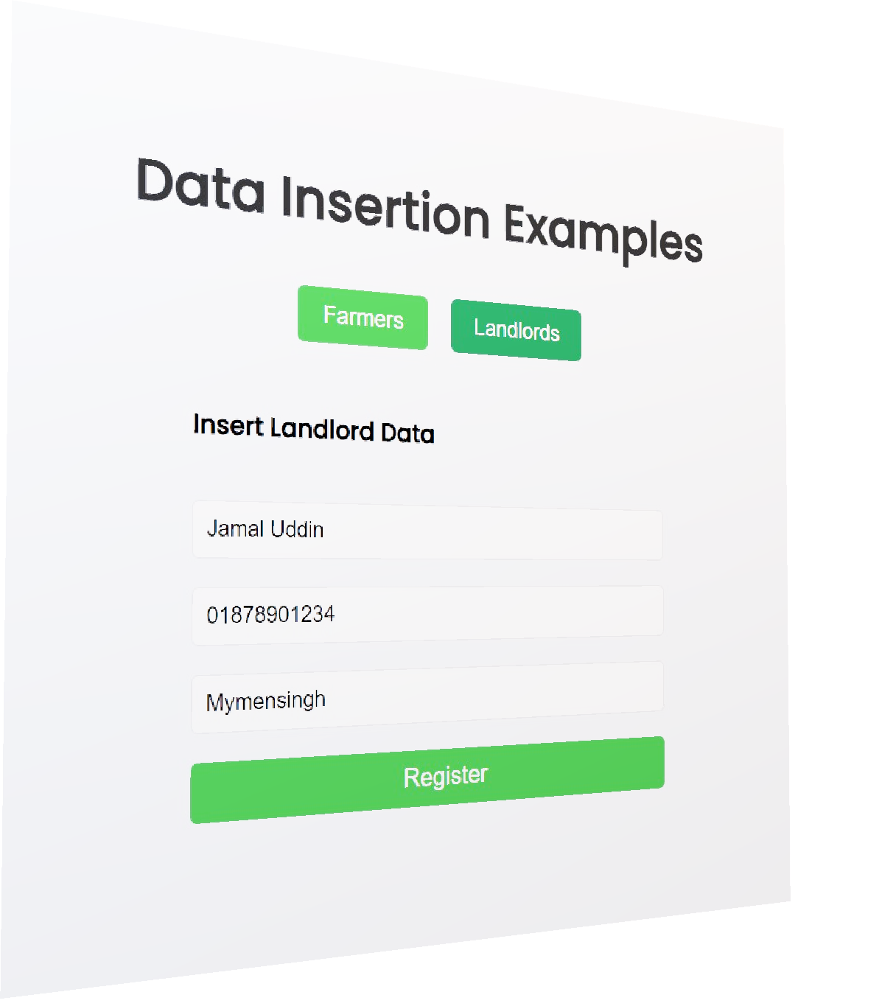
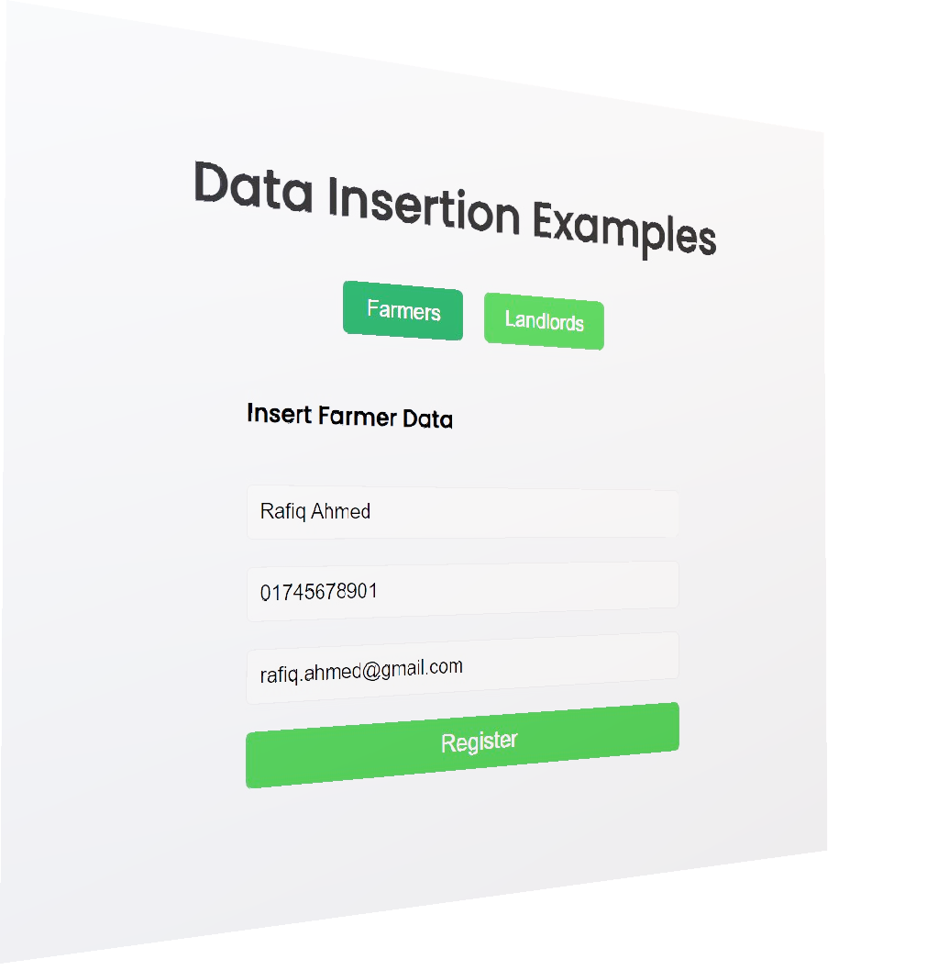
Data Insertion Examples
Landlords
Notes:
: Farmers lack a systematic way to monitor crop health, leading to missed interventions and reduced yields.

Slide 22
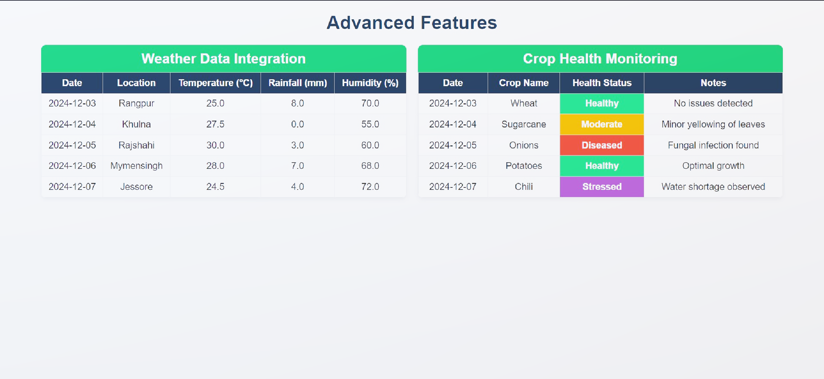
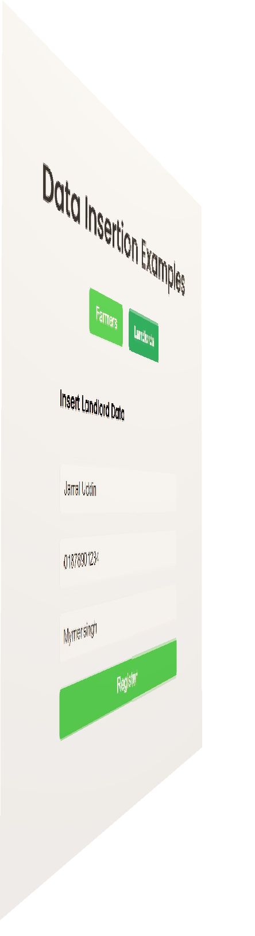
Advanced Features
Notes:
: Farmers lack a systematic way to monitor crop health, leading to missed interventions and reduced yields.

Slide 23
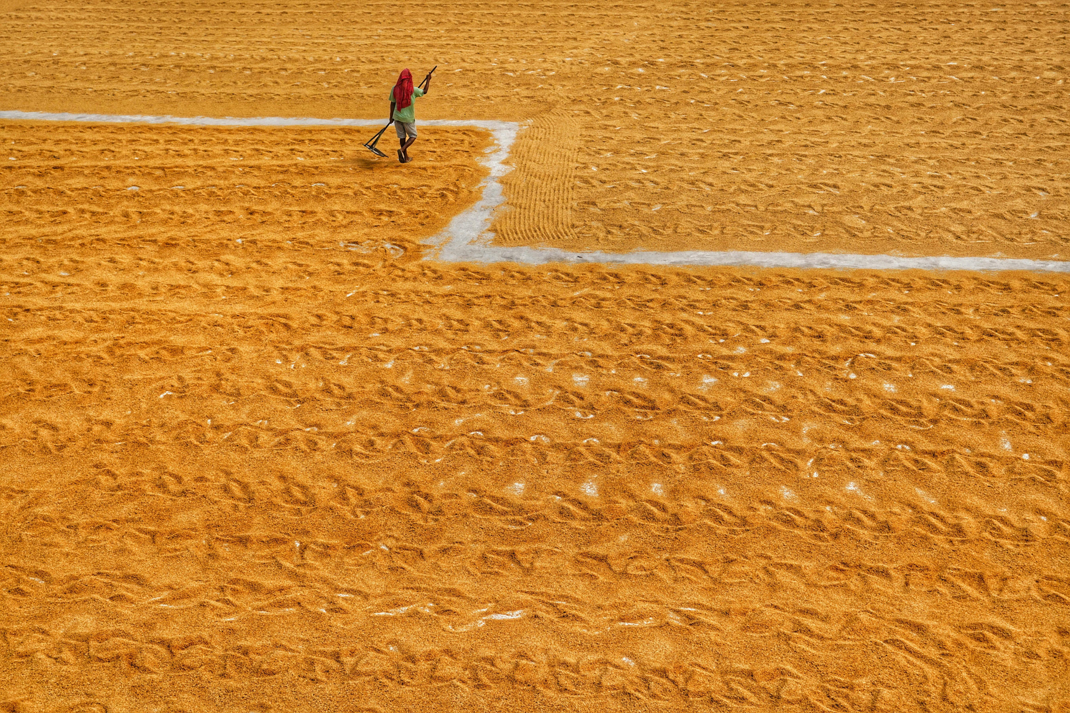
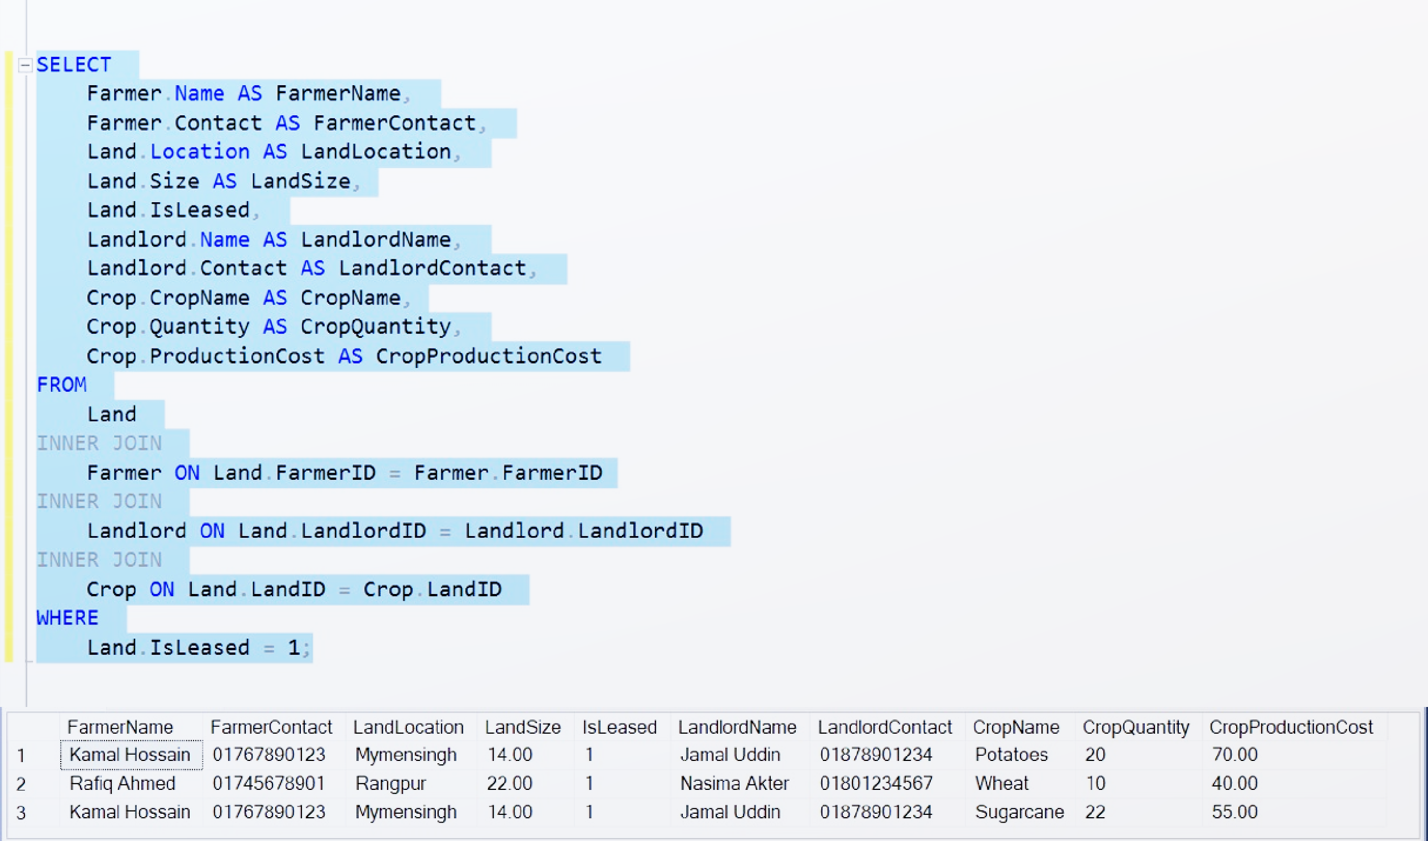
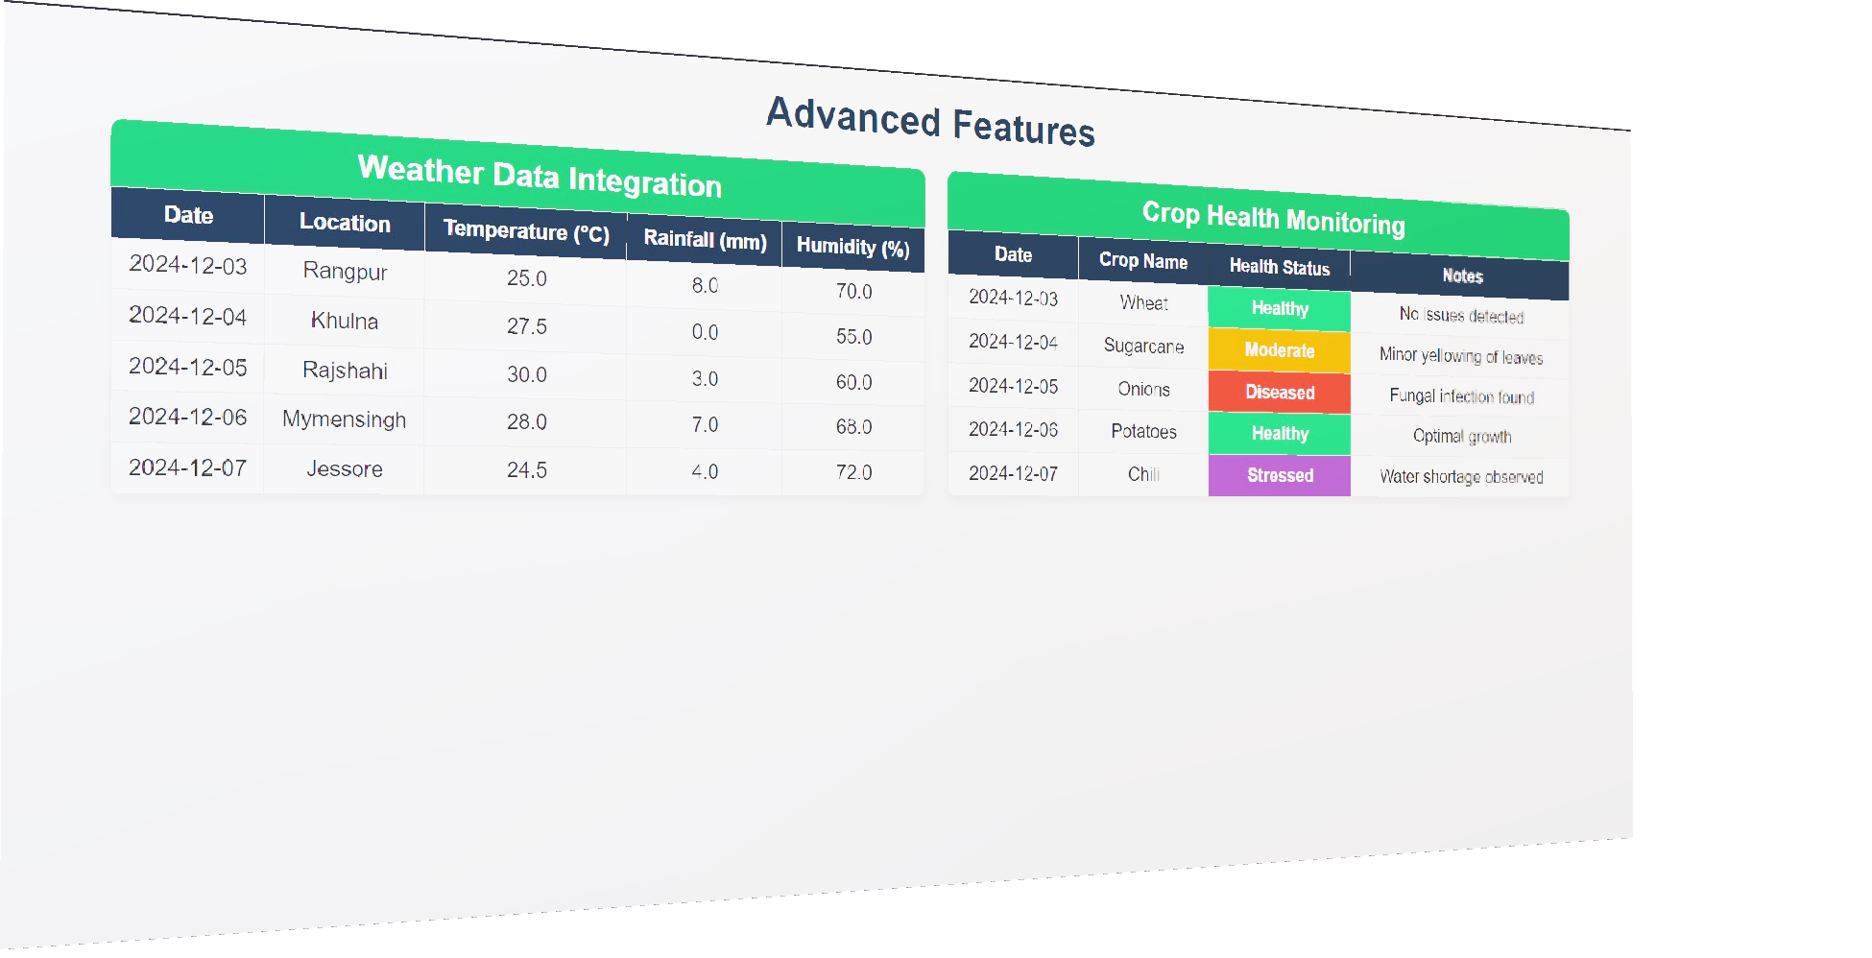
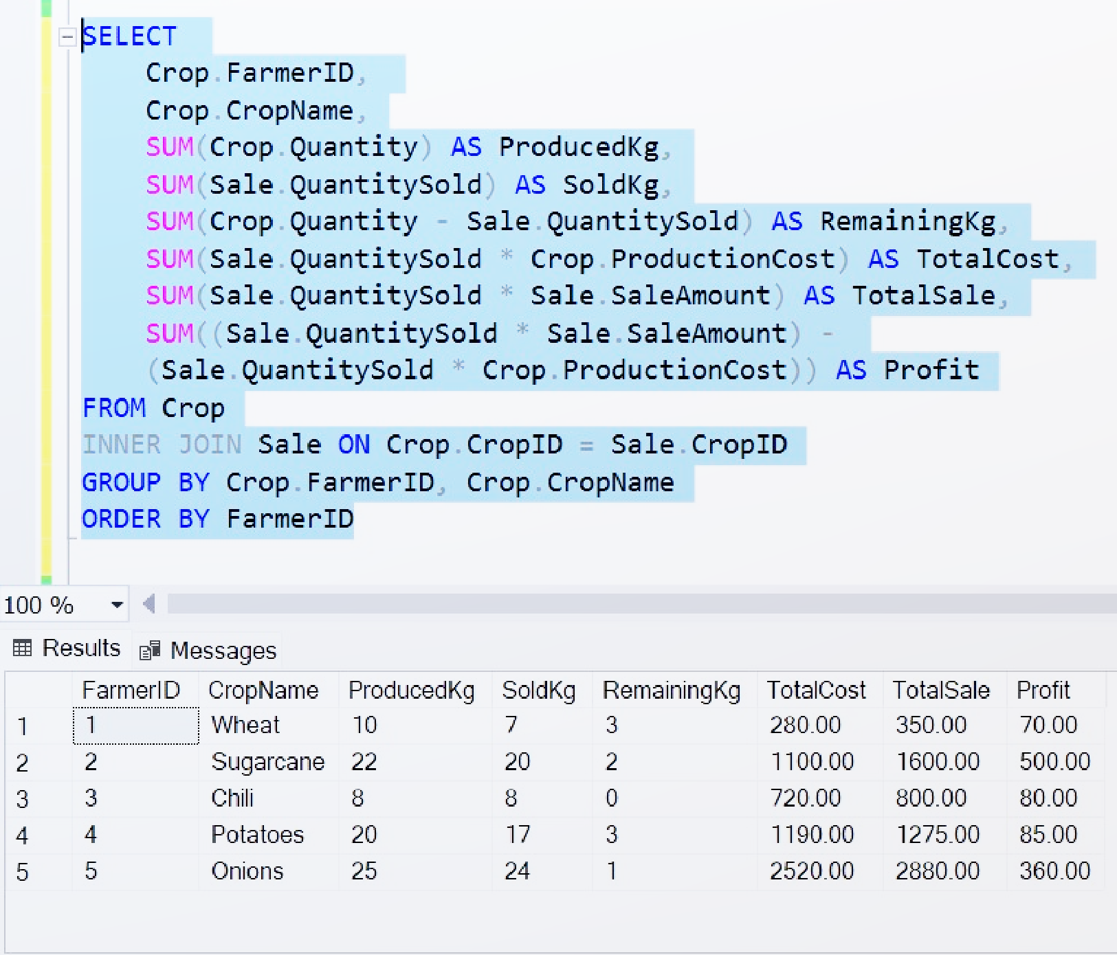
Advanced Features
Weather Data Integration: Records temperature, rainfall, and humidity.
Crop Health Monitoring: Status updates with inspection dates.
Notes:
: Farmers lack a systematic way to monitor crop health, leading to missed interventions and reduced yields.

Slide 24
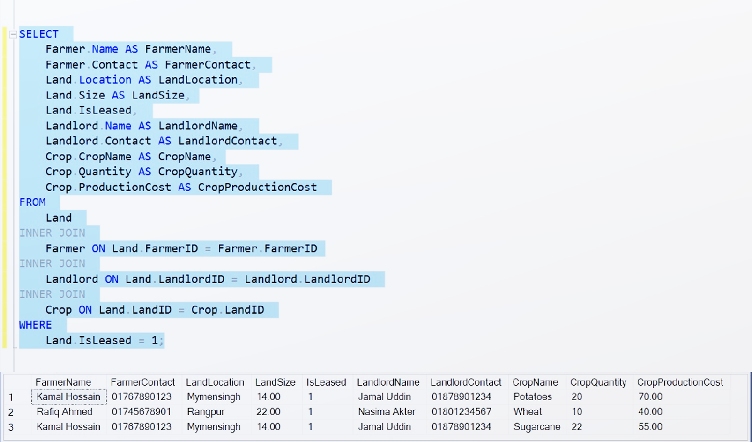

Query Examples
Notes:
: Farmers lack a systematic way to monitor crop health, leading to missed interventions and reduced yields.

Slide 25
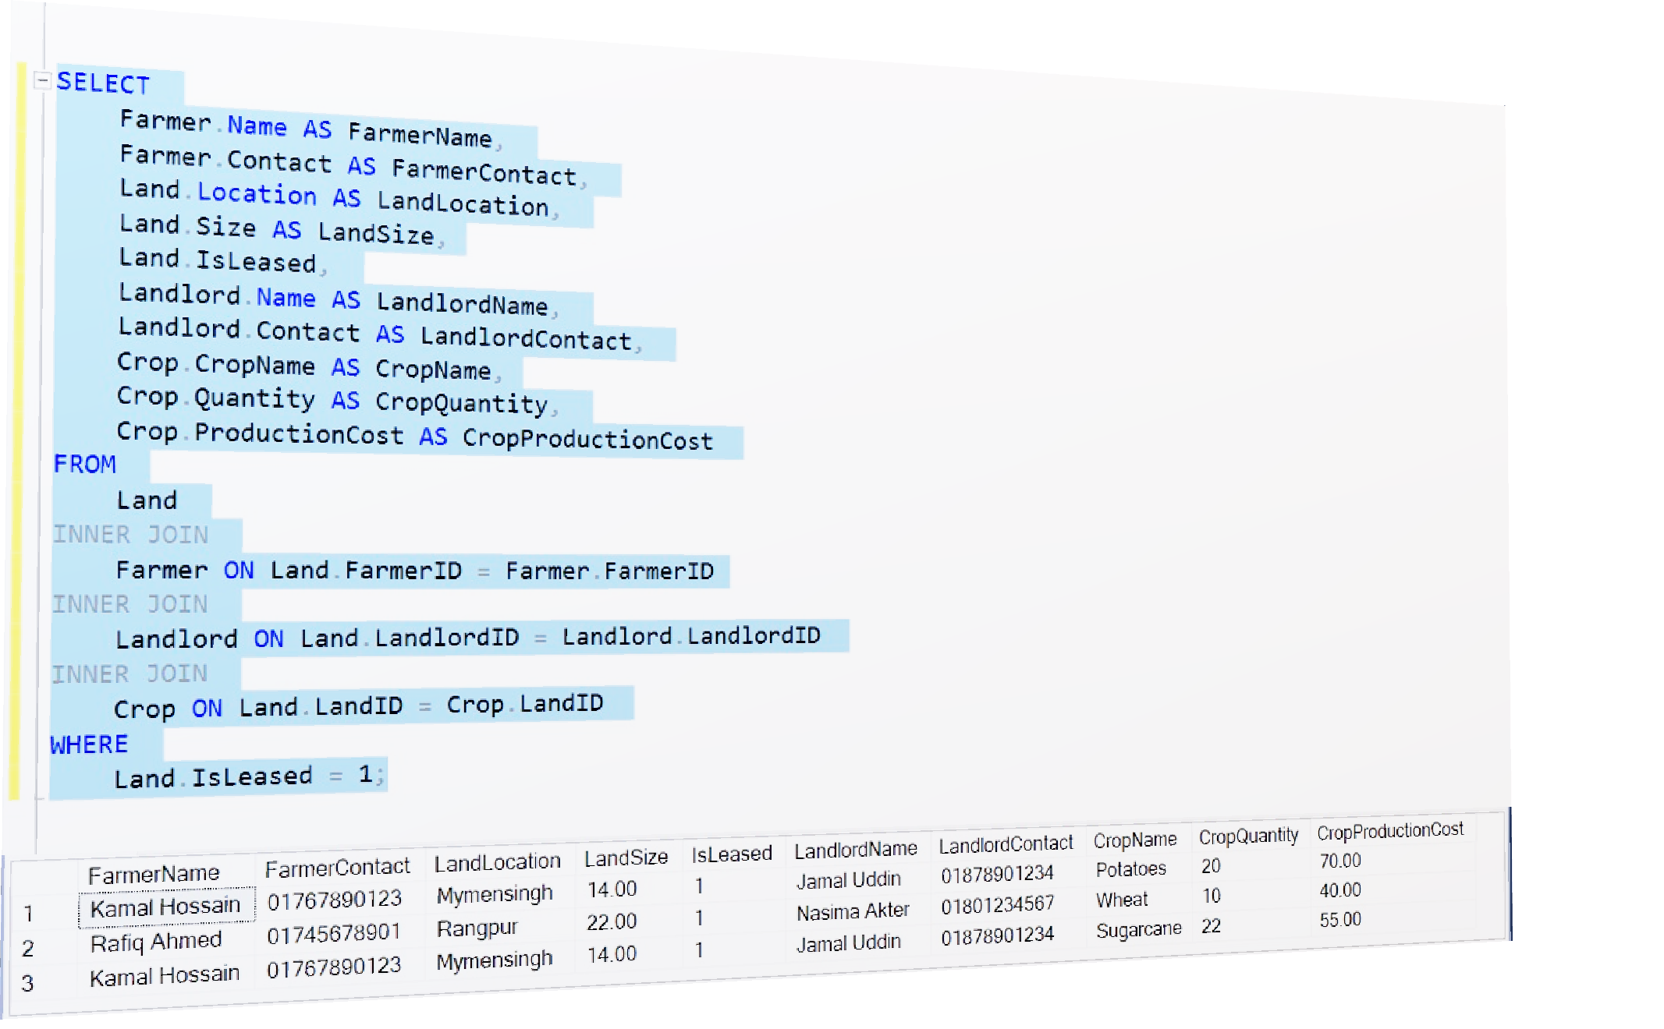
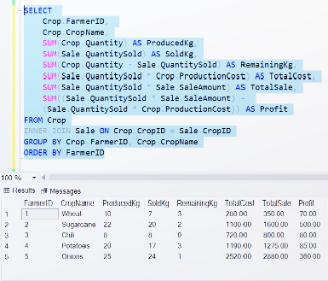
Query Examples
Notes:
: Farmers lack a systematic way to monitor crop health, leading to missed interventions and reduced yields.

Slide 26
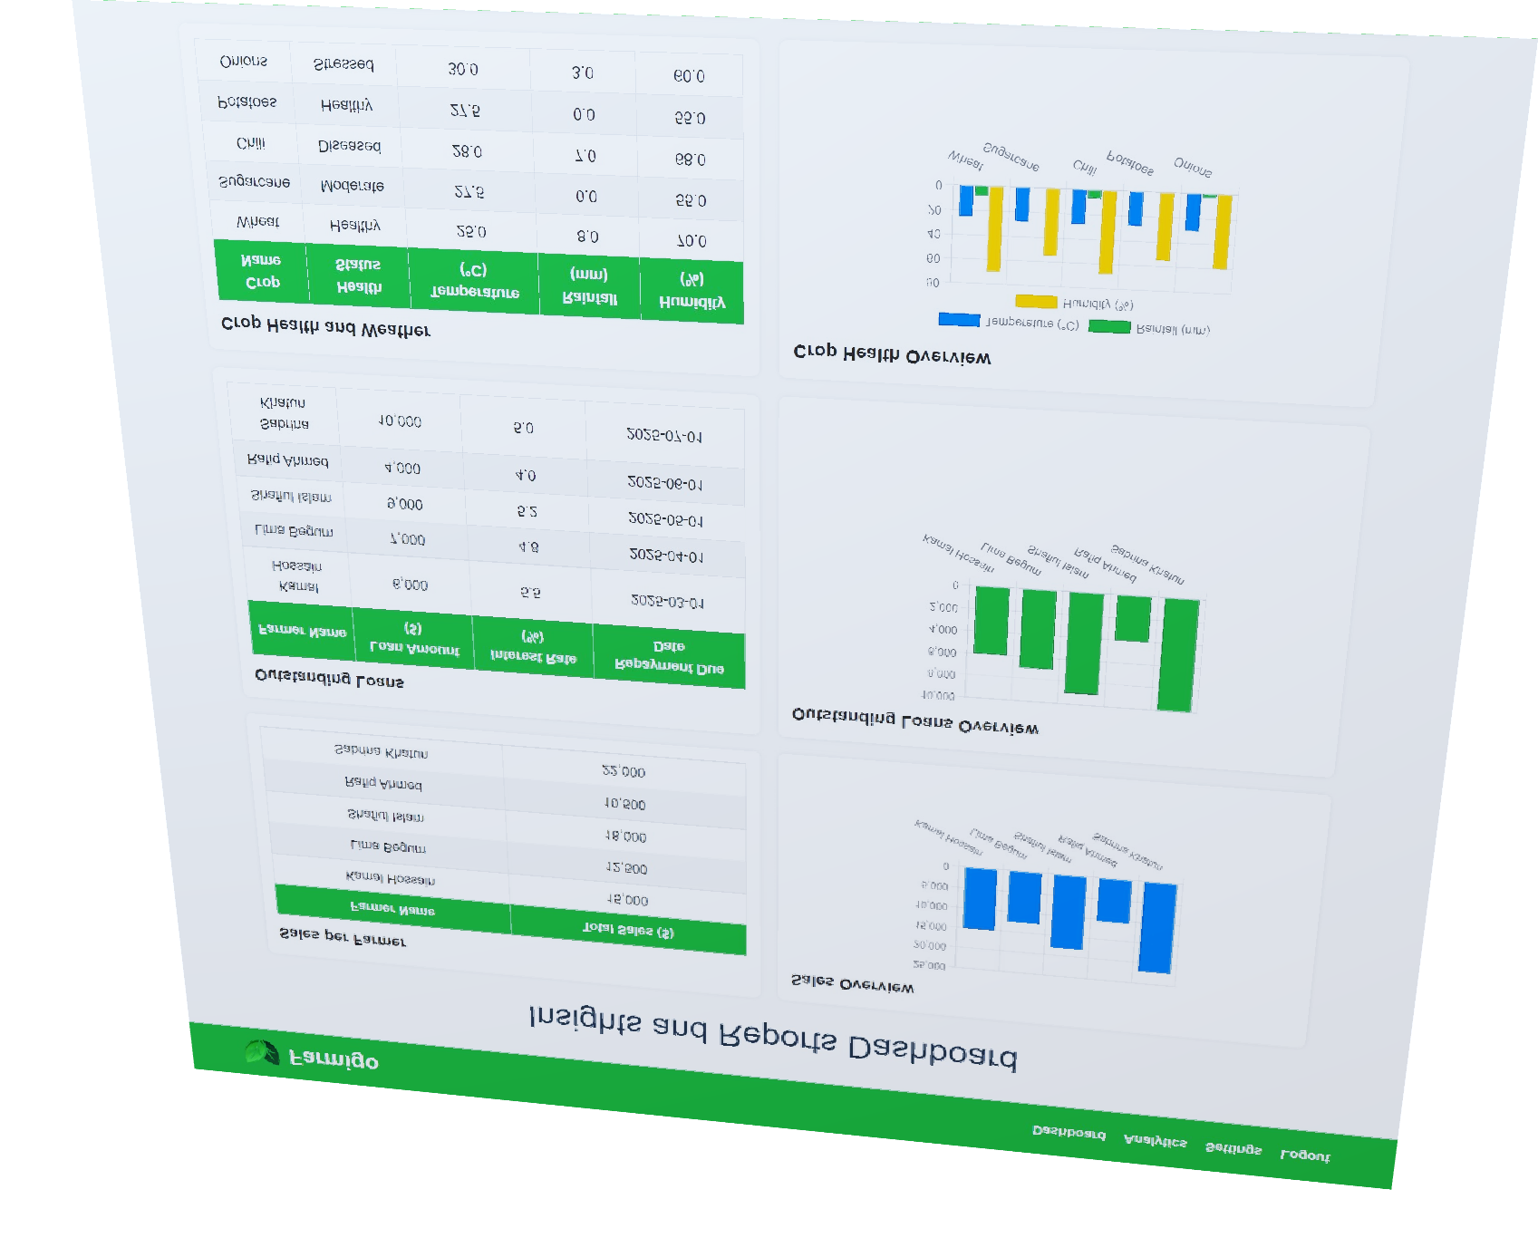
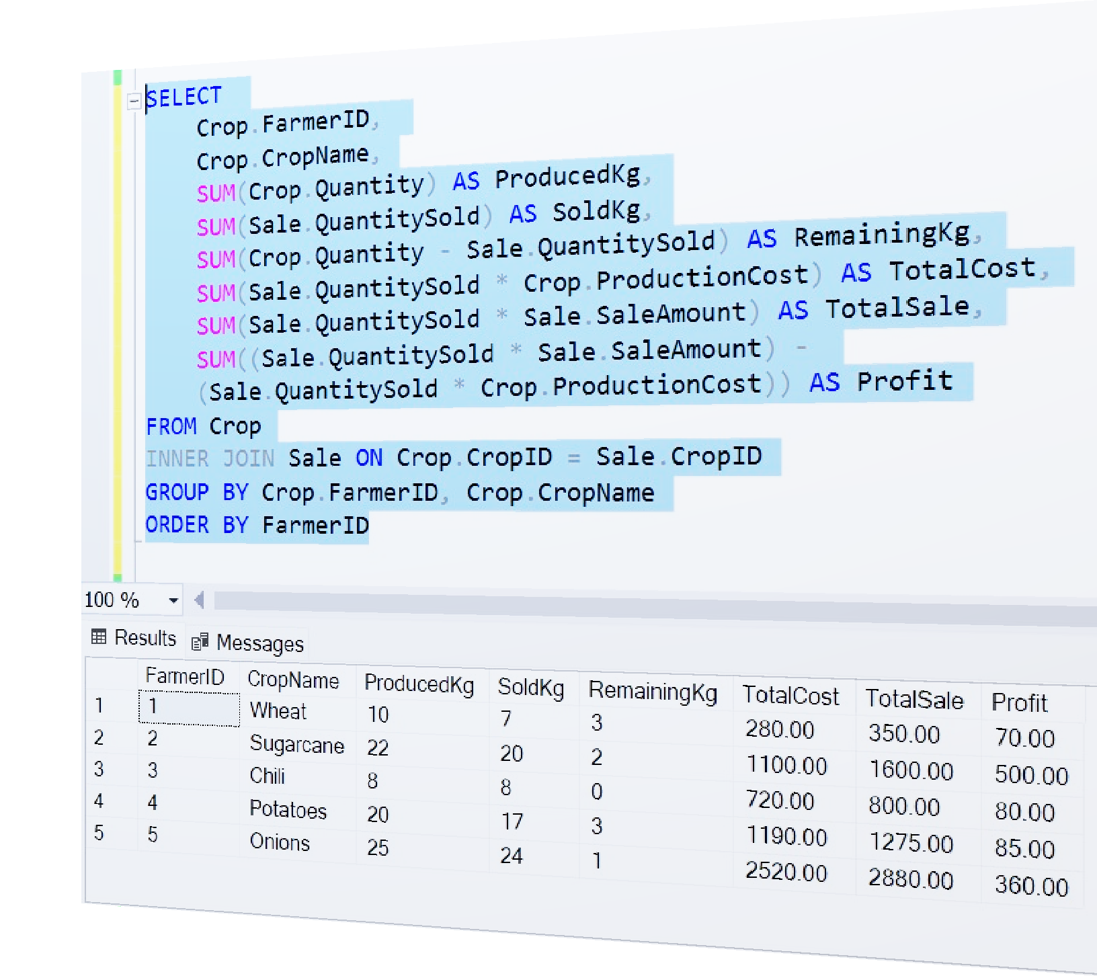
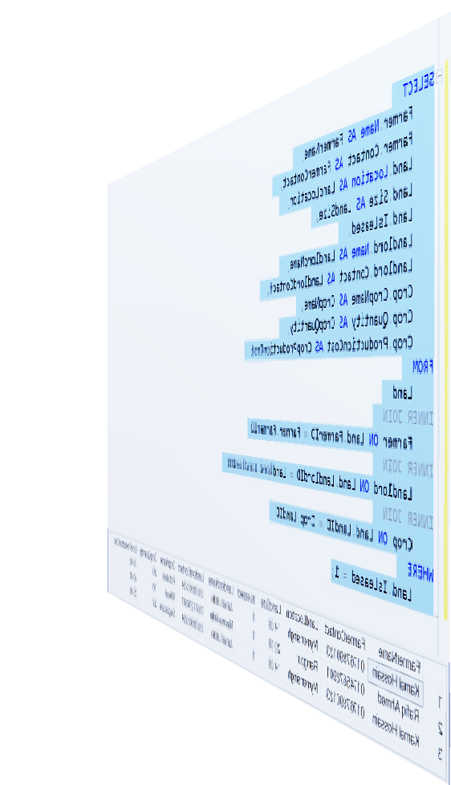
Query Examples
Notes:
: Farmers lack a systematic way to monitor crop health, leading to missed interventions and reduced yields.

Slide 27
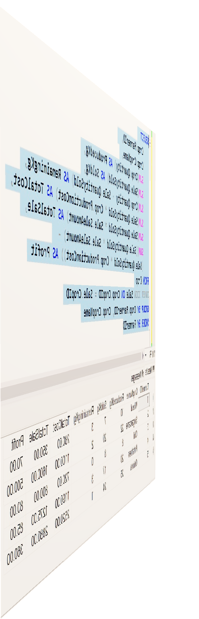
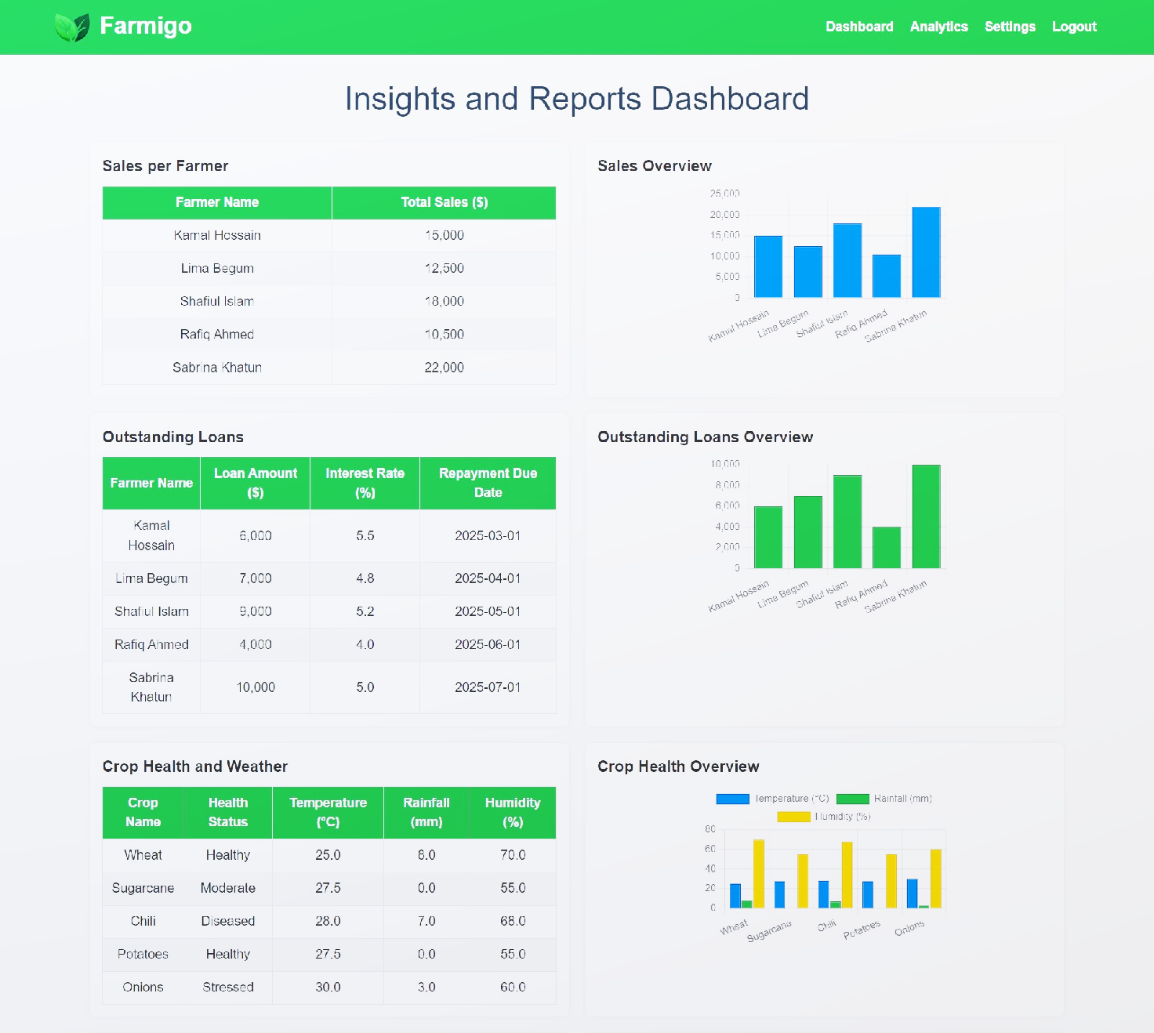
Insights and Reports
Notes:
: Farmers lack a systematic way to monitor crop health, leading to missed interventions and reduced yields.

Slide 28
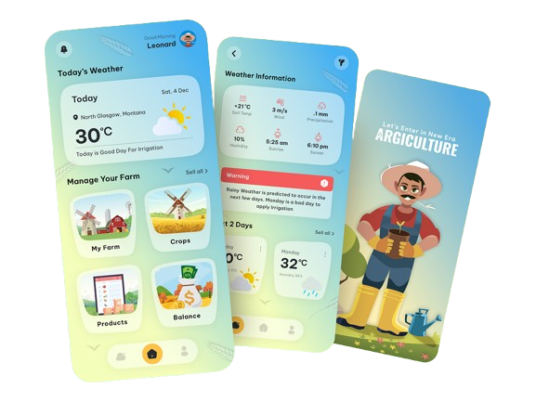
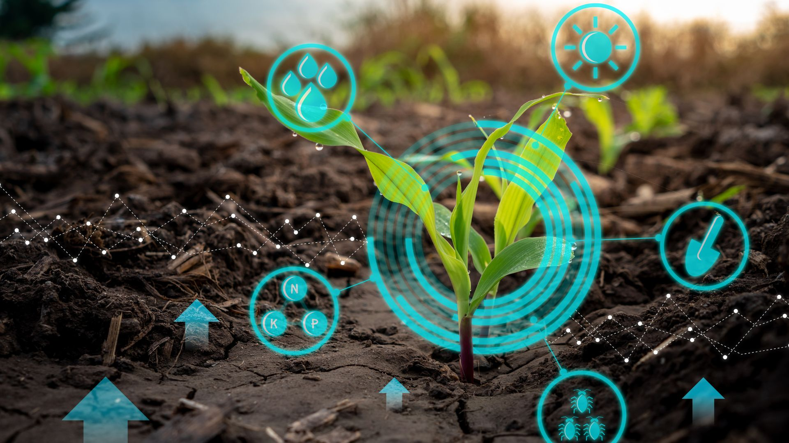
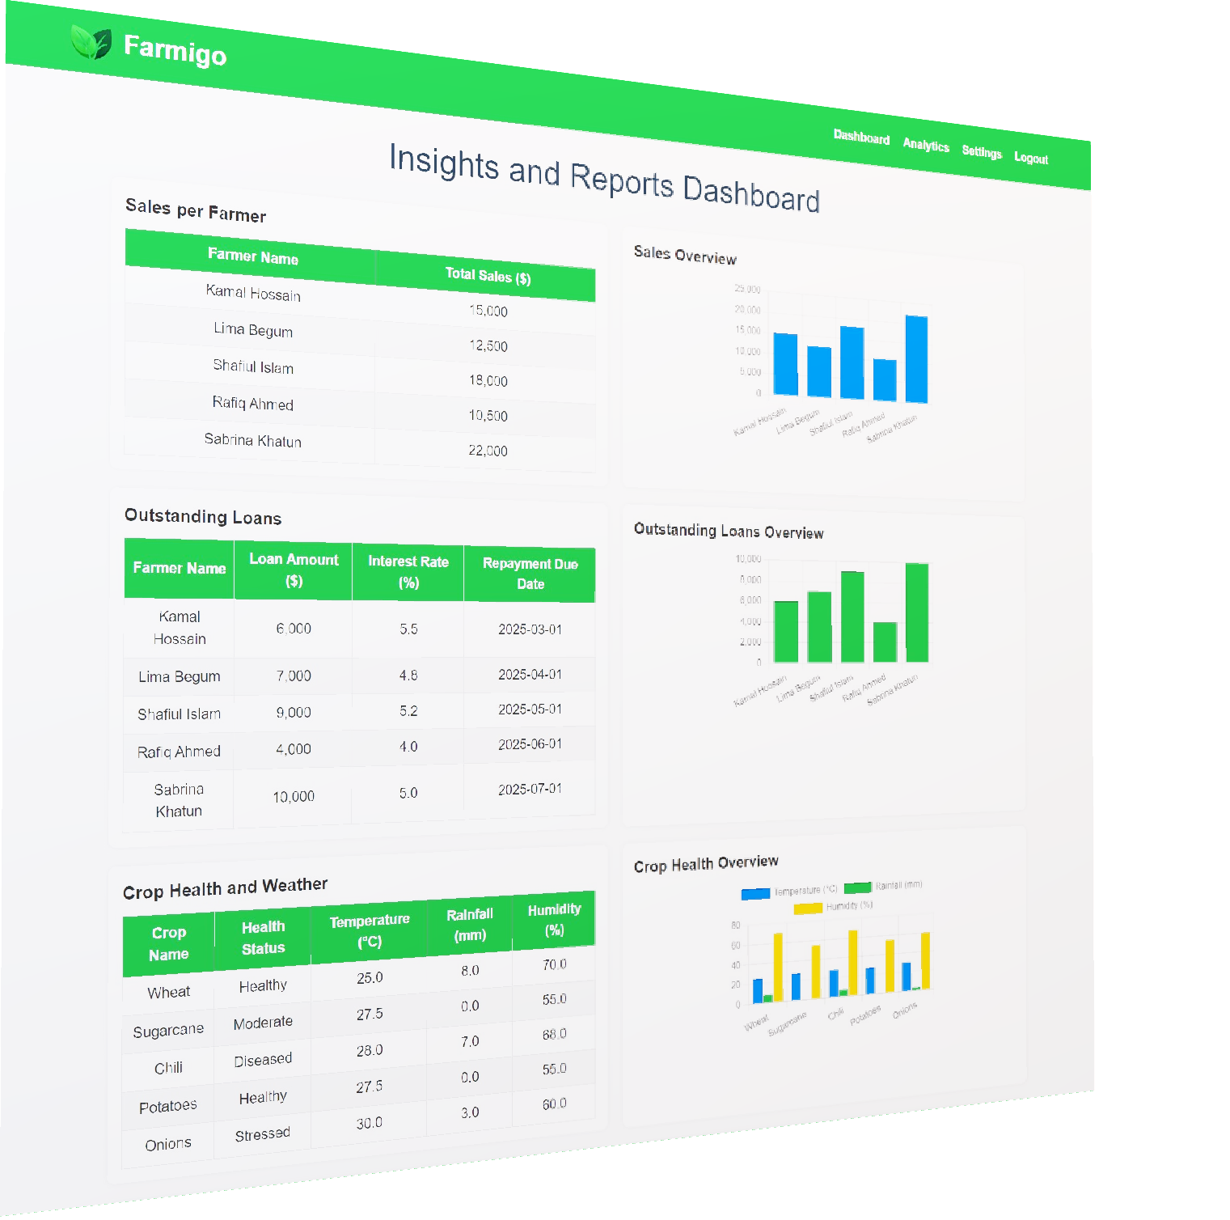
Insights and Reports
Outstanding Loans: Farmers with unpaid loans.
Weather Impact: Conditions affecting crop health.
Sales Analysis: Revenue from crops and buyers.
Yield Categories: Classify crops based on production quantity.
Notes:
: Farmers lack a systematic way to monitor crop health, leading to missed interventions and reduced yields.

Slide 29
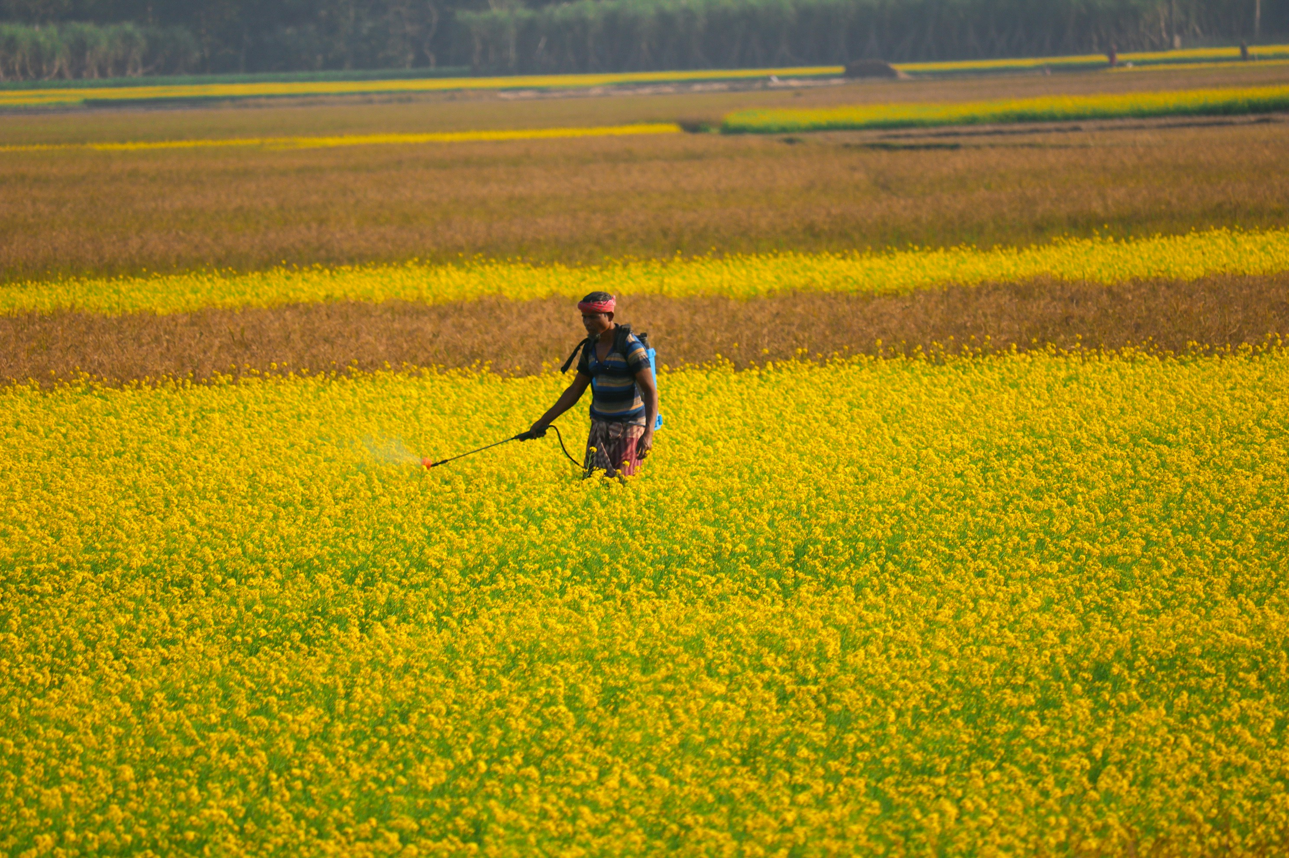
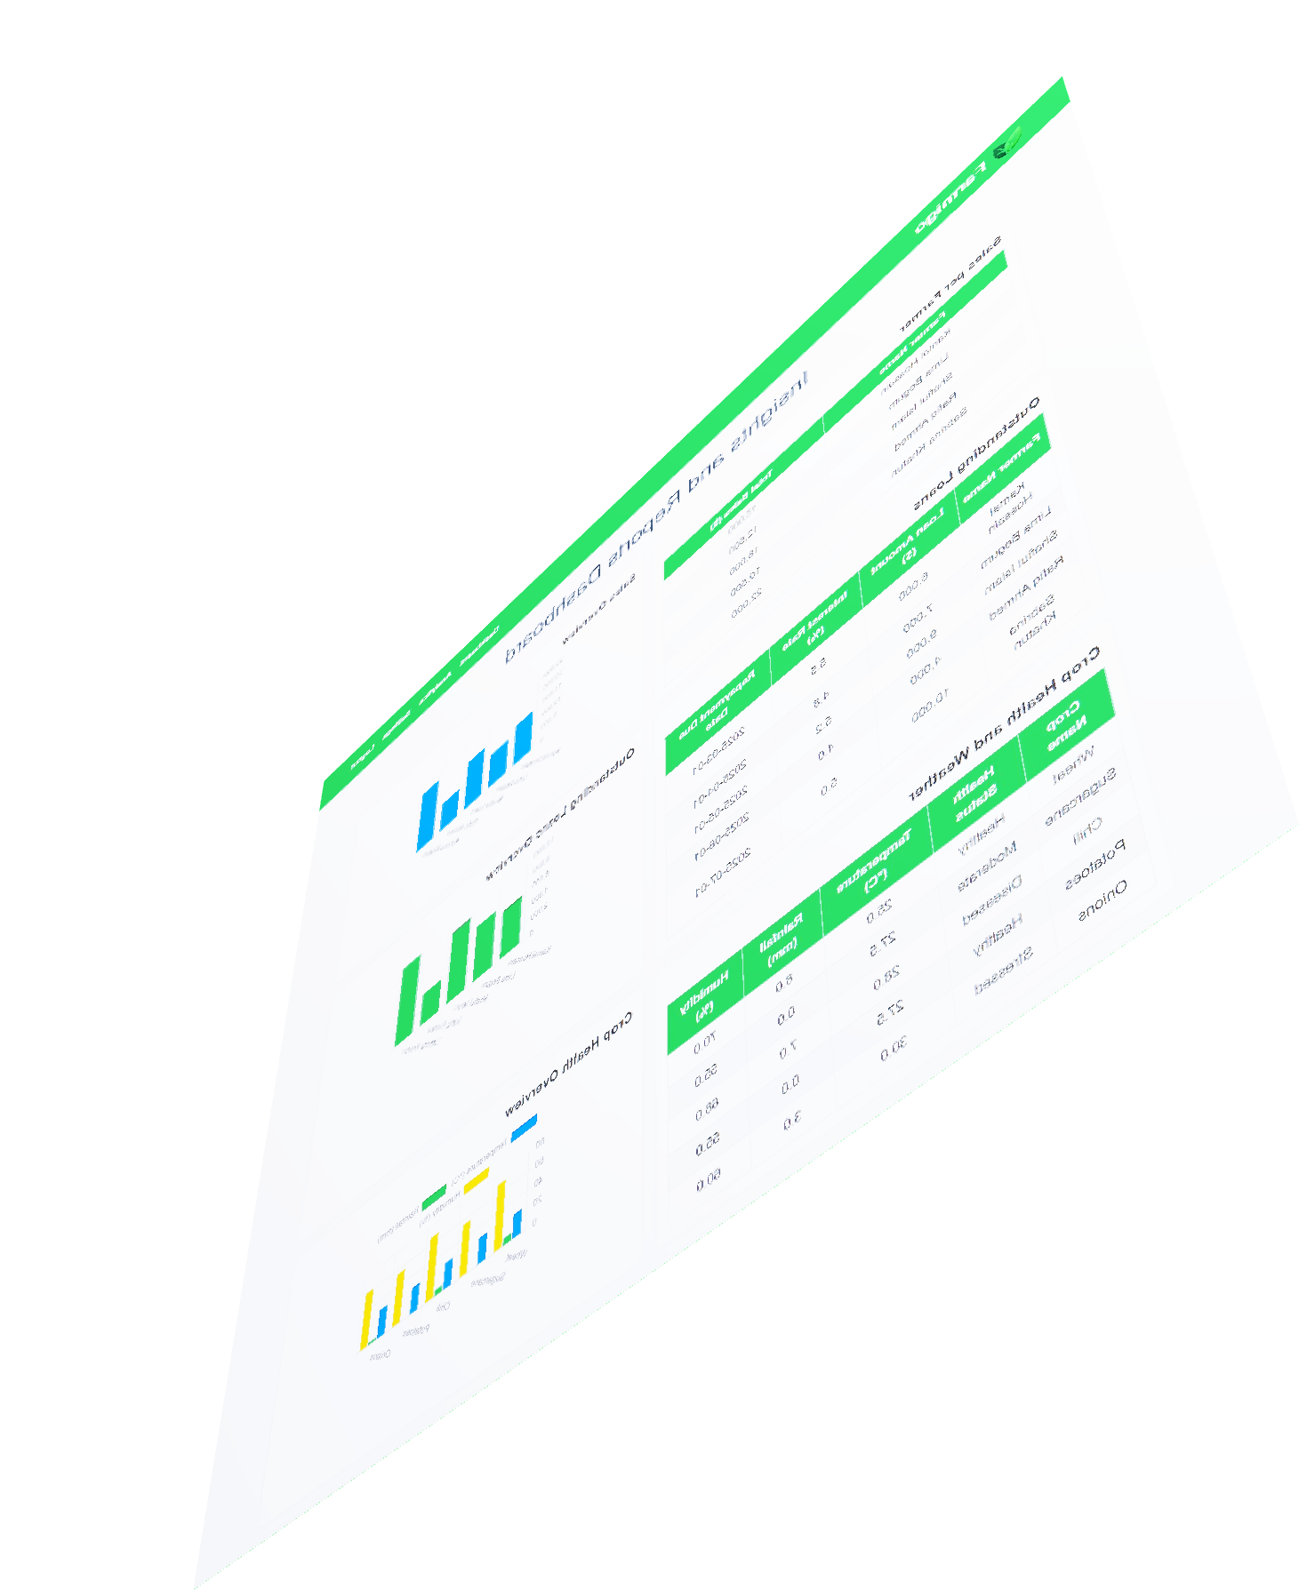
Future Enhancements
Mobile App Integration: Instant updates for farmers.
Predictive Analytics: Machine learning for yield forecasting.
Visualization Dashboards: User-friendly data summaries.
Drone/Satellite Data: Advanced land and crop monitoring.
Notes:
: Farmers lack a systematic way to monitor crop health, leading to missed interventions and reduced yields.

Slide 30



Presented by:
C231197 – Md. Mohiul Islam Miraz
Notes:
: Farmers lack a systematic way to monitor crop health, leading to missed interventions and reduced yields.

Slide 31
Thank you for your time. Any Questions?
Notes:
: Farmers lack a systematic way to monitor crop health, leading to missed interventions and reduced yields.

